Slide 1




FORA: Simple and Effective Approximate Single­-Source Personalized PageRank
Sibo Wang, Renchi Yang, Xiaokui Xiao, Zhewei Wei, Yin Yang

Slide 2
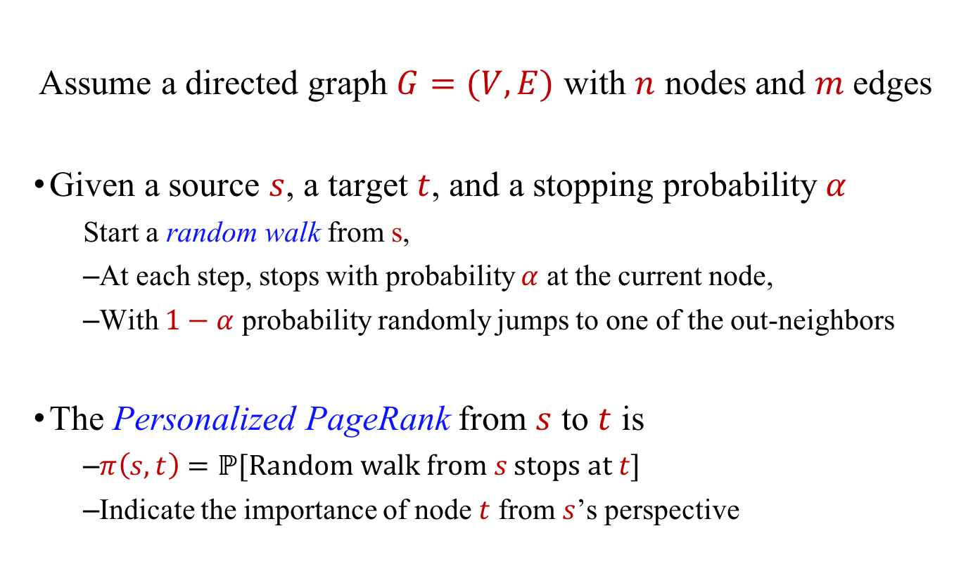
Personalized PageRank
Assume a directed graph $G=(V,E)$ with $n$ nodes and $m$edges
Given a source $s$, a target $t$, and a stopping probability $α$
  Start a random walk from s,
  At each step, stops with probability $α$ at the current node,
  With $1−α$ probability randomly jumps to one of the out-neighbors
The Personalized PageRank from $s$ to $t$ is
  $π\left(s,t\right)=ℙ[Random walk from s stops at t]$
  Indicate the importance of node $t$ from $s$’s perspective
Notes:
The personalized PageRank is defined as following. We assume that we have a directed graph G with n nodes and m edges. Then given a source and a target, and a stopping probability alpha, we start a random walk from s, such that at each step, we stop at the current node with alpha probability, and with 1-alpha probability, it randomly jumps to one of its out-neighbors.
The personalized PageRank from s to t is defined as the probability that the random walk from s stops at t. It indicates the importance of node t form s’s pespective

Slide 3


Applications
Personalized Web Search
  [Haveliwala et al. WWW’2002]
Friend Recommendation
  Twitter Who-to-Follow
    [Gupta et a., KDD’2013]
Named Entity disambiguation
  [Pershina et al. ACL’15]
Notes:
Personalized PageRank has many applications in our everyday life. For instance, it can be used for the personalized web search. For example, the importance of the web pages are different from different user’s pespective. The personalized PageRank can capture this property and return better search results. It has been also used in friend recommendation. For example, in Twitter, we can usually see that it is giving Who to follow recommendations. In this service, they use the personalized PageRank to find the nodes are important to a user’s and use them for recommendation. Also, it has been used in named entity disambiguation in knowledge graphs. For instance, if two entities both has name apple but their personalized pagerank is small, then we know that they are highly likely different entities.

Slide 4
Outline
Problem Definition
Existing work
Proposed solution
Experiments
Summary

Slide 5
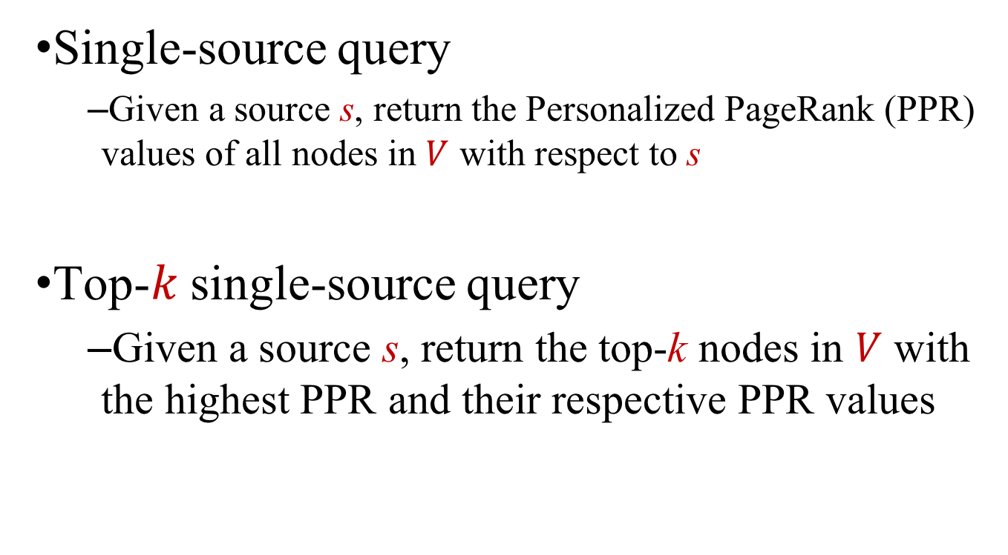
Studied Queries
Single-source query
  Given a source s, return the Personalized PageRank (PPR) values of all nodes in $V$ with respect to s
Top-$k$ single-source query
  Given a source s, return the top-k nodes in $V$ with the highest PPR and their respective PPR values
Notes:
In this paper, we mainly study two types of queries. The first is the single-source Personalized PageRank query, in which case,…
The second query we studied is the top-k single-source query, where we are given a source s, and we need to return …

Slide 6
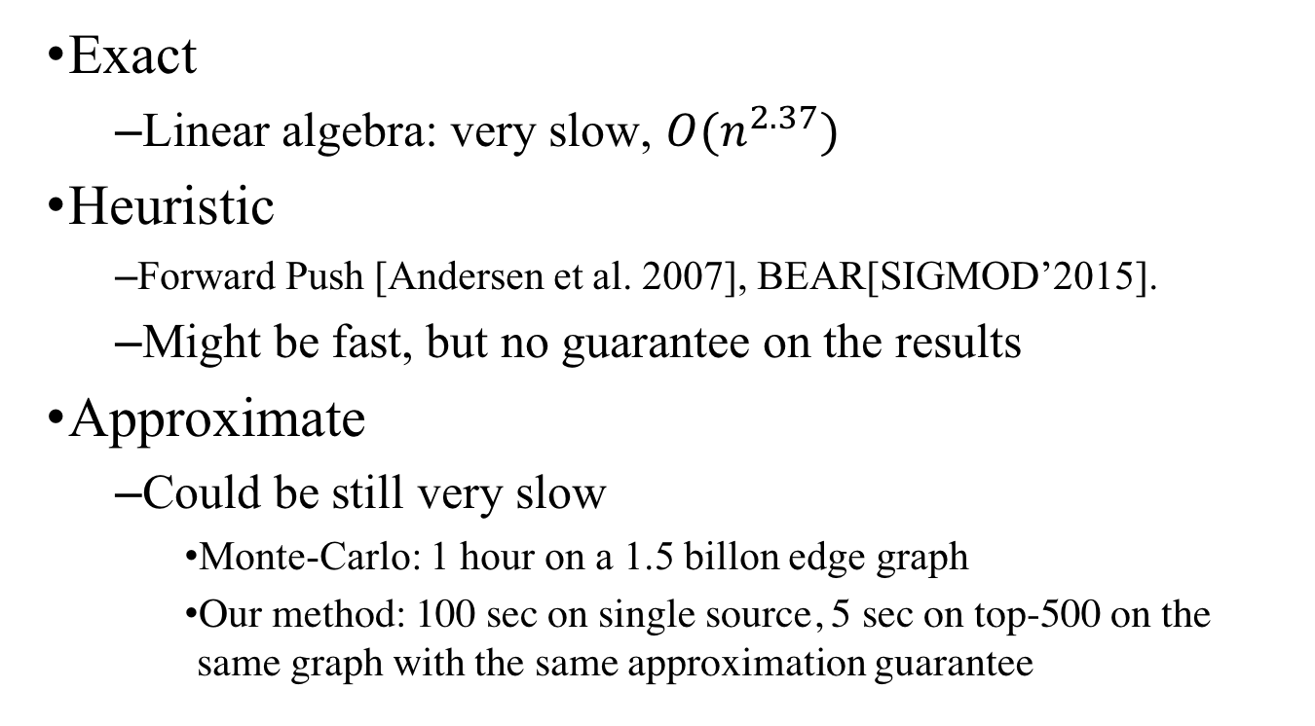
Possible ways
Exact
  Linear algebra: very slow, $O(n^{2.37})$
Heuristic
  Forward Push [Andersen et al. 2007], BEAR[SIGMOD’2015].
  Might be fast, but no guarantee on the results
Approximate
  Could be still very slow
    Monte-Carlo: 1 hour on a 1.5 billon edge graph
    Our method: 100 sec on single source, 5 sec on top-500 on the same graph with the same approximation guarantee
Notes:
There are several possible ways to solve the two problems. The first way is to provide the exact answer for the two problems, which is rather expensive. The second way to solve the problem is heurstic. For instance, the forwrad push algorithm, the BEAR solution. These solutions might be fast, but we cannot provide guarantee on the returned results, and the results might be very bad.
The third way to solve the problem is using approximation. But approximate solutions can still be very slow on large graphs. For instance, if we run Monte-Carlo on a 1.5 billon edge graph, we need 1 hour to return the answer.
Our solution belongs to this caterogry, and provides much better efficiency than existing soltuions. In particular, On the same graph, to provide the same approximation guarantee, we only need 100 second on a single source query, and 5 second on a top-500 query.

Slide 7
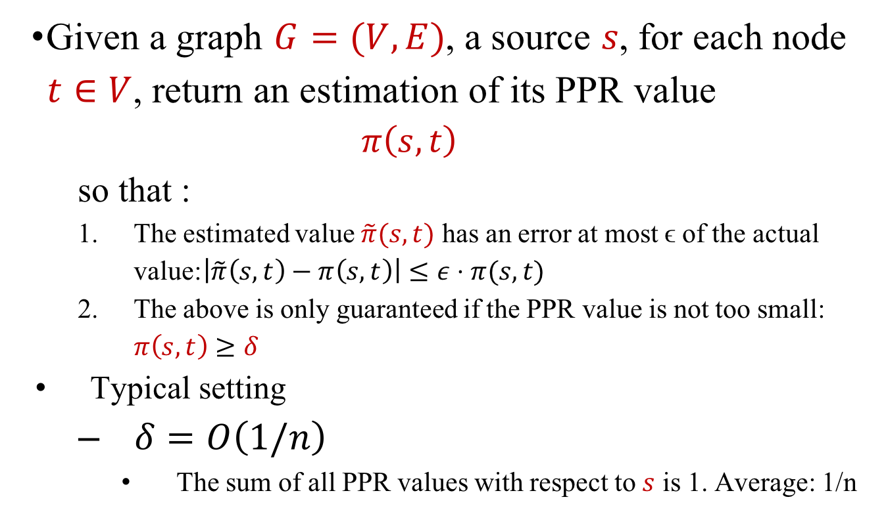
Approximate version of single-source PPR
Given a graph $G=(V,E)$, a source $s$, for each node $t∈V$, return an estimation of its PPR value
  $$π\left(s,t\right)$$
  so that :
  The estimated value $\tilde{π}(s,t)$ has an error at most ϵ of the actual value:$\left|\tilde{π}\left(s,t\right)−π\left(s,t\right)\right|≤ε⋅π(s,t)$
  The above is only guaranteed if the PPR value is not too small: $π\left(s,t\right)≥δ$
Typical setting
  $δ=O\left(1/n\right)$
    The sum of all PPR values with respect to $s$ is 1. Average: 1/n
* n: the number of nodes in the graph
Notes:
Next, we define the approximate verison of the two problems. In the approximate single-source PPR, given a source node s, for each node t in V, we need to return an estimtion of its PPR value pi(s,t) so that the estimated value hat pi(s,t) has an error at most epsilon of the actual value. Also, the above is only guaranteed if the PPR value is not too small, larger than a pre-defined threshold delta. The typical setting of delta is O(1/n). To explain, the sum of all PPR values with respect to s is 1. The average of the PPR values is 1/n. We then guarantee that we provide approximate for results that are above the average

Slide 8





Approximate version of top-k PPR query
Given graph $G=(V,E)$, a source $s$
  Return $k$ nodes in V and their respected estimated PPR values
  so that :
  Ignore PPR values smaller than 𝛿
  Each returned PPR value can have up to $ε$ relative error
  The i-th returned node has a PPR score close to the i-th real largest PPR in V, with at most $ε$ relative difference.
$δ=0.01$, $ε=0.1$
$$s=v_{1},V=\left\{v_{1},v_{2},v_{3},v_{4},⋯,v_{100}\right\}$$
$π\left(s,v_{1}\right)=0.45$, $π\left(s,v_{2}\right)=0. 2,π\left(s,v_{3}\right)=0.18$, $π\left(s,v_{4}\right)=0.17$
An answer for the approximate top-3 PPR query:
$$\tilde{π}\left(s,v_{1}\right)=0.45,\tilde{π}\left(s,v_{2}\right)=0.2, \tilde{π}\left(s,v_{4}\right)=0.18$$
$$\tilde{|π}\left(s,v_{4}\right)−π\left(s,v_{4}\right)|≤0.1∗π\left(s,v_{4}\right)$$
$$|π\left(s,v_{4}\right)−π\left(s,v_{3}\right)|≤0.1∗π\left(s,v_{3}\right)$$
Notes:
Similarly, the approximate top-k PPR query can be defined as follows: the query returns k nodes and their respected estimated PPR values so that we ignore the PPR values smaller than delta, each returned PPR value can have up to epsilon relative error. Furthermore, our i-th returned node must has a PPR value score close to the i-th real largest PPR in V, and it has at most epsilon difference against the real i-th largest PPR. Here is an example.
Assume that we have delta equlas 0.01 epsilon=0.1 s is v_1, and V includes v_1 to v_100. The true PPR values are as follows. The omitted ones has zero PPR values
Then, the following is a possible answer for the approximate top-3 PPR query.
To explain, all the PPR values are no smaller than delta, and to check conditions 2,&3 it is easy to verify that v_1 and v_2 saitsity the conditions 2 and 3 since the estimated value is the same as the true value. For estimated pi(s<v_4) (click), its relative difference against the true ppr value of pi(s,v_4) is no larger than epsilon, so condition 2 satisified. For condition 3, the third largest PPR value is pi(s,v_3). Compared to pi(s,v_3), pi(s,v_4) bears no more than epsilon difference of the pi(s,v_3). So condition 3 is also satisfied, and hence the returned result is an answer for the approximate top-3 PPR query.

Slide 9
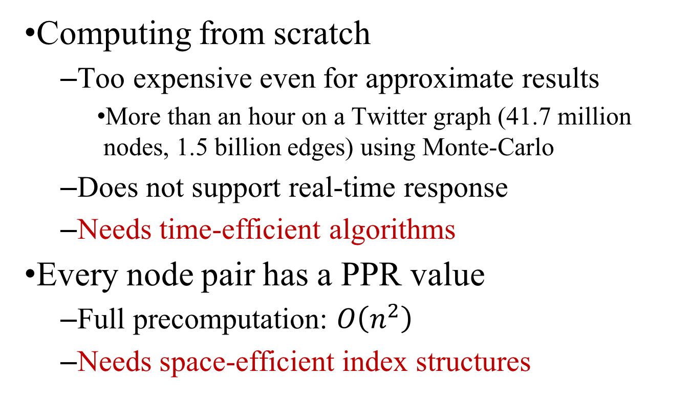
Main Challenge
Computing from scratch
  Too expensive even for approximate results
    More than an hour on a Twitter graph (41.7 million nodes, 1.5 billion edges) using Monte-Carlo
  Does not support real-time response
  Needs time-efficient algorithms
Every node pair has a PPR value
  Full precomputation: $O\left(n^{2}\right)$
  Needs space-efficient index structures
Notes:
Tere are mainly two challenges here. If we compute from scratch, it is too expensive even for approximate results. For instance, on a Twitter graph, with 1.5billion edges, if we use the Mote-Carlo method. To answer the single source PPR query, it requires more than an hour. As a result, it does not support real-time responses and more time-efficient algorithms are required.
The other challenge of the personalized pagerank is that every node pair has a PPR value. If we pre-store all these PPR values, we need O(n^2) space, which is too costly. As a result, we need more space-efficient index structures

Slide 10
Outline
Problem Definition
Existing work
Proposed solution
Experiments
Summary
Notes:
Next we will see the existing approximate solutions

Slide 11
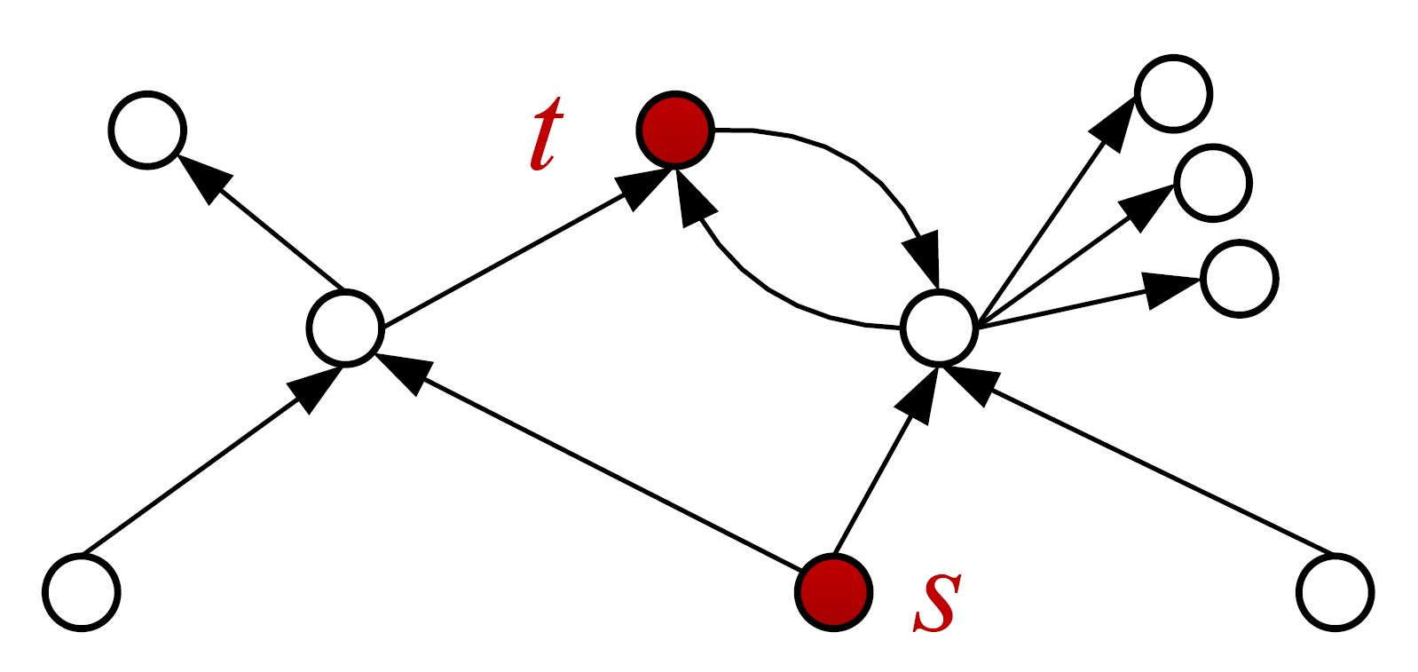
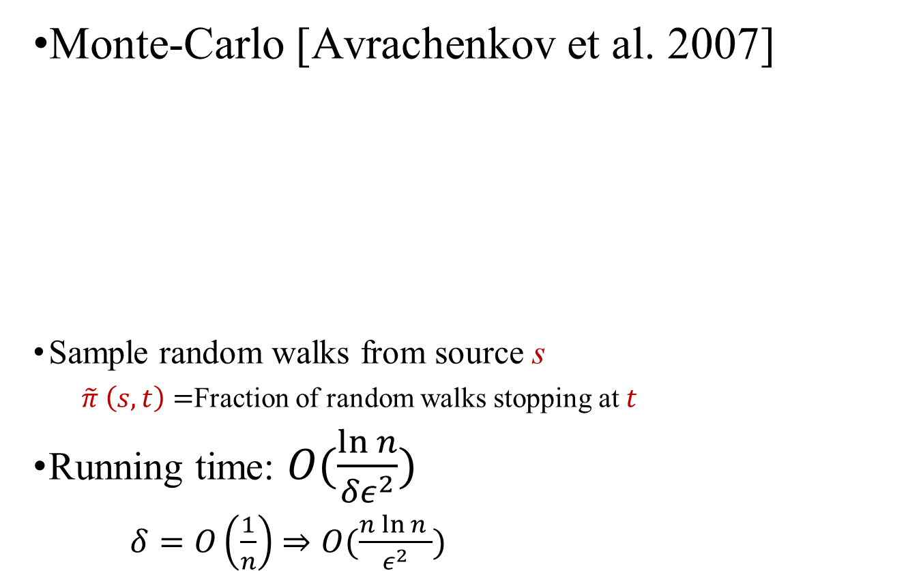

Existing Approximate Solutions (i)
Monte-Carlo [Avrachenkov et al. 2007]
Sample random walks from source s
  $\tilde{π} \left(s,t\right)=$Fraction of random walks stopping at $t$
Running time: $O(\frac{\ln{n}}{{δε}^{2}})$
    $δ=O\left(\frac{1}{n}\right)$ $⇒O(\frac{n\ln{n} }{ε^{2}})$
$$\tilde{π}\left(s,t\right)=\frac{1}{3}$$
Notes:
The classic solution for the approximate PPR is the Monte-Carlo approach. It samples a set of random walks from source s, and uses the fraction of random walks ending at t as the estimated PPR.
For example, assume that we have three random walks starting from s, and only one stops at t, then the estimated pi(s,t) is 1/3.
The running time of the Monte-Carlo approach is O(lnn / delta eps^2). As delta is 1/n, then the time complexity is O(nlnn /epi^2)

Slide 12

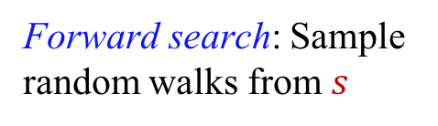
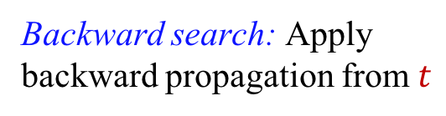






Existing Approximate Solutions (ii)
BiPPR [Lofgren et al. WSDM’15]
  Answer PPR query for any node pair $(s,t)$
    Combining Monte-Carlo and backward propagation
$$v_{1}$$
$$v_{1}$$
$$v_{1}$$
s
...
$$v_{2}$$
t
$$v_{3}$$
$$v_{1}$$
Forward search: Sample random walks from $s$
Backward search: Apply backward propagation from $t$
Notes:
Recently, Lofgren et al. proposed BiPPR, which answers PPR queries for any node pair.
The high level idea of BiPPR is to combine the Monte-Carlo approach and the backward propagation. In particular, it starts a forward search from the source s by sampling random walks from s. Simultaneously, it starts a backward search from the target node t using the backward propagation. Since we start search from both sides, it is more efficient than simply do the random walk from the source node.

Slide 13

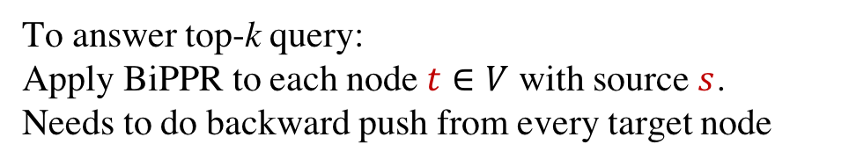
BiPPR
  Amortized time complexity:
    $O(\frac{1}{ε}\sqrt{\frac{m}{nδ}\ln{n}})$
    $δ=\frac{1}{n} ⇒O(\frac{1}{ε}\sqrt{m\ln{n}})$
To answer top-k query:
Apply BiPPR to each node $t∈V$ with source $s$.
Needs to do backward push from every target node
Notes:
Since it only answers the PPR query for one node pair, the amortized time complexity can be much better than the Monte-Carlo approach, and is this one. However, when we use it handle the top-k PPR query (click), we need to apply BiPPR to each node with the source s, and needs to do backward push from every target node, rendering it inefficient in single source queries.

Slide 14
Outline
Problem Definition
Existing work
Proposed solution
Experiments
Summary
Notes:
This motivates us to derive a more efficient framework.

Slide 15
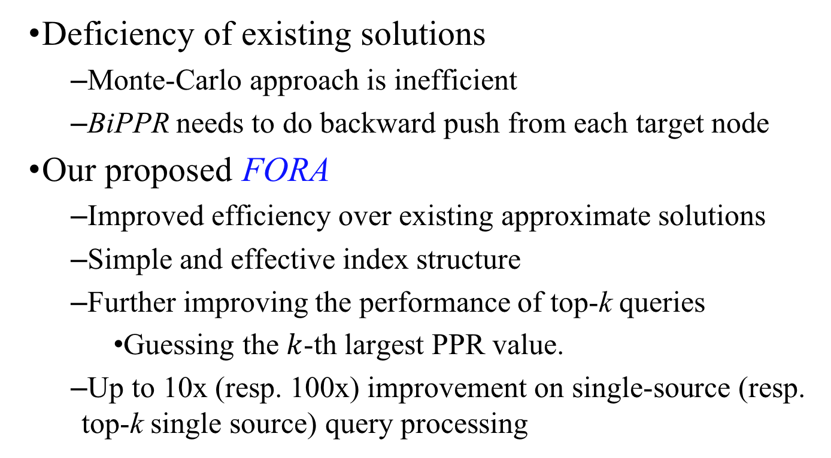
Motivation & Contribution
Deficiency of existing solutions
  Monte-Carlo approach is inefficient
  BiPPR needs to do backward push from each target node
Our proposed FORA
  Improved efficiency over existing approximate solutions
  Simple and effective index structure
  Further improving the performance of top-k queries
    Guessing the $k$-th largest PPR value.
  Up to 10x (resp. 100x) improvement on single-source (resp. top-k single source) query processing
Notes:
Our motivation is quite simple: existing approximate solutions are not fast enough.
(click)
In our proposed FOR A, we provide better query efficiency over existing approximate solutions. We further propose a simple and effective index structure that can significantly improve the query efficency. Moreover, we propose an iterative approach for the top-k PPR query algorithm by guessing the k-th largest PPR value and stop as soon as the approximation is guaranteed.
Our solution can be up to a order of magnitude faster than existing soltuions on single source queries and two order of magnitude faster than existing solutions on top-k queries.

Slide 16
FORA
Combining FOrward push + RAndom walks
  Forward push [Andersen et al. 2007]:
    Derives exact result with high cost
    Stops early but provides no approximation guarantee
  Random Walks using Monte-Carlo
    Provides approximation guarantee but inefficient
Notes:
The high level idea of FOR A is to combe the forward push with random walks. The two algorithms are actaully not new. The forward push algorithm is proposed in 2007, and it can derive exact rsult with high cost or stop early but provides no approximatio guarantee. The random walk algorithm using Monte-Carlo provides approximation guarantee but is rather inefficient. Next, we show how combining these two algorithms help improve the efficiency

Slide 17

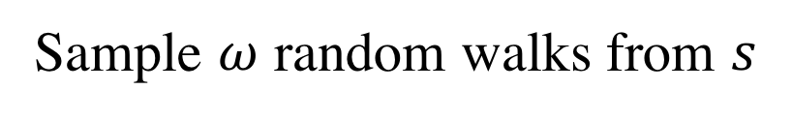
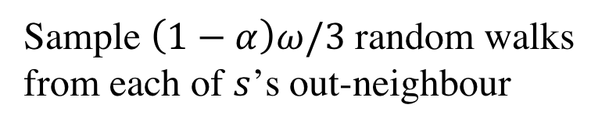
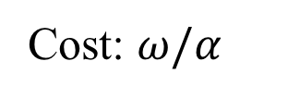
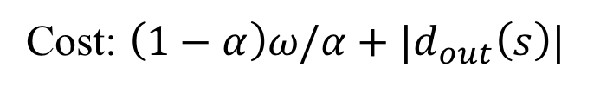









Intuition
  If we sample $ω$ random walks from s, how many will reach $v_{1}$ in expectation?
Sample $ω$ random walks from $s$
$$v_{1}$$
$$(1−α)ω/3$$
$$α⋅ω$$
Cost: $ω/α$
$$s$$
$$v_{2}$$
$$(1−α)ω/3$$
$$v_{3}$$
$$(1−α)ω/3$$
Sample $\left(1−α\right)ω/3$ random walks from each of $s$’s out-neighbour
$α$: random walk stopping probability
Cost: $\left(1−α\right)ω/α+|d_{out}\left(s\right)|$
Notes:
Let‘s first see the intuition. Given this subgraph containing s and its out-neighbors, if we need to sample omega ranom walk from s, how man will reach node v_1? The answer is (1-alpha)*omega/3. To explain (click), alpha portion will terminate at node s, and since the remaining random walk will randomly jumps to one of its out-neighbors (click), so the number is this one. Then, we analyze the cost of these two sampling methods. (
clickIn the first case, we need to generate omega random walks, and the expected length of a random walk is 1/alpha, so the cost is this one.
(click) For the second case, since we only need to generate (1-a)*omega random walks, the cost is this one. Note that there is a d_out(s) term here. Recall that we need to calculate the random walk numbers for its out-neighbors, so we need a cost of d_out(s). So as long as the cost of the second one is less than the first one, we can improve the efficiency. Given the intuition, we are now prepared to present how to combine them to derive the new algorithm.

Slide 18










Recap: Forward Push (i)
Each node $v$ maintains a residue $r(s,v)$ and reserve $\hat{π}(s,v)$
  Residue: the portion of random walks stopped at v
  Reserve: the portion of random walks currently at node v, but not stopped yet.
$$v_{1}$$
$$r\left(s,v_{1}\right)=(1−α)/3$$
$$\hat{π}\left(s,s\right)=α$$
$$s$$
$$v_{2}$$
$$r\left(s,v_{2}\right)=(1−α)/3$$
$$v_{3}$$
$$r\left(s,v_{3}\right)=(1−α)/3$$
$α$: random walk stopping probability
Notes:
We use the forward push algorithm to calculate the number of random walks needed from each node.
The forward push algorithm maintains a residue and a reserve for each node v, and we can understand as follows. The residue of node v denotes the portion of random walks that has stopped at node v, and the reserve of node v is the portion of random walks that are currently at node v. For instance, for the previsou result, we have that (click), the reserve of node s is alpha, and the residue of v_1 to v_3 with respect to 3 are all (1-alpha)/3

Slide 19

Recap: Forward Push (ii)
Yes
Terminates
$r\left(s,s\right)=1,$others all 0
𝑟(𝑠,𝑠)=1,others all 0
$$∃v∈V,\frac{r\left(s,v\right)}{d_{out}\left(v\right)}>r_{max}$$
∃𝑣∈𝑉,𝑟(𝑠,𝑣)/(𝑑_𝑜𝑢𝑡 (𝑣) )>𝑟_𝑚𝑎𝑥
Yes
Do forward push from v
No
No
$r_{max}$: pre-defined threshold
Notes:
The whole flow of forward push algorithm is as follows. Initially, the r(s,s) is 1 and the others are zero. We then check if there exists a node such that its residue divided by its number of out-neighbor is larger than a pre-defined threshold r_max. If so, we do a forward push from this node, and recheck the condition. If no node has residue such that its vlue divided by its out-degree is no larger than rmax, we terminate

Slide 20

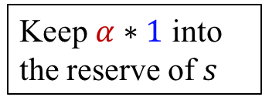
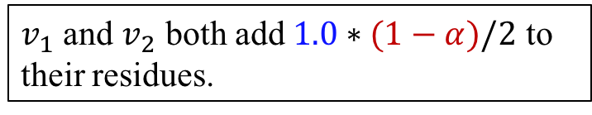
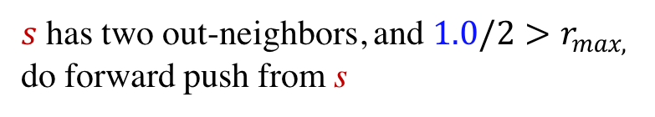
Forward Push Example
$r_{max}=0.1, α=0.2$
Keep $α∗1$ into
the reserve of $s$
$s$ has two out-neighbors, and $1.0/2>r_{max,}$
do forward push from s
1
s
0.4
v
v
$v_{1}$ and $v_{2}$ both add $1.0∗(1−α)/2$ to their residues.
1
2
0.4
v
3
node
s
v
v
v
1
2
3
reserve
0
0
0
0
0.2
Blue numbers: residue
Notes:
Here，we show an example of how forward push works. Suppose we set rmax = 0.1, alpha is 0.2, and we do forward push from node s. Here we use blue numbers next to the node to denote the residues, and the reserves are show in the table below. Initially, we check node s, since it has two out-neighbors, and its residue divided by 2 is larger than rmax, we then do the forward push as follows. Firslty, it keeps alpha portion of the residue to its reserve. Next, it propgates the remaining residues evenly to its out-neighbors. (click) As a result, v_1 and v_2 both add this number to their residue, half of the remaining residues for each.

Slide 21

Forward Push Example
$r_{max}=0.1, α=0.2$
0.32
1
s
0.4
v
v
0.4*0.2
1
2
0.4
0.4*0.2
v
0.32
3
v
v
v
node
s
v
v
v
node
s
1
2
3
1
2
3
reserve
0
.
2
0
0
0
reserve
0
0
0
0
0.08
0.08
Notes:
Next, since v_1 has rmax 0.4 and its out-neighbor is only one, so we still need to the forward push from v_1. We first keep alpha portion of the residue to its reserve, and propgates the remaining (1-alpha)portion to its neighbors. Since v_1 has only one out-neighbor v_3, v_3 add all the remaining residue to its own residue. We repeat this process until the stopping condition is satisfied.

Slide 22
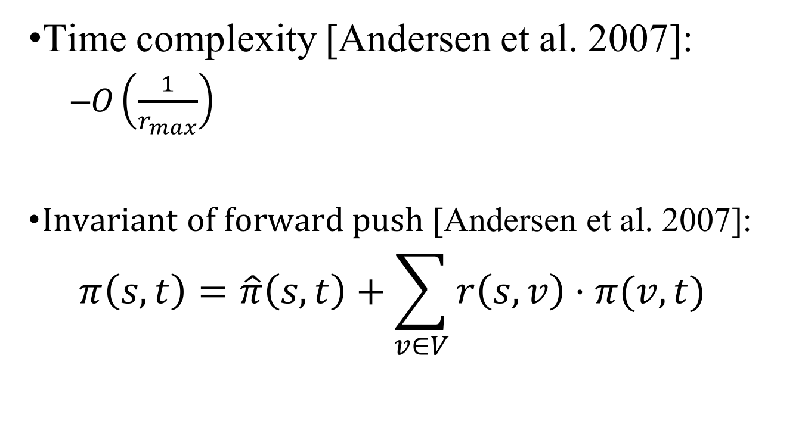
Forward push phase
Time complexity [Andersen et al. 2007]:
  $O\left(\frac{1}{r_{max}}\right)$
Invariant of forward push [Andersen et al. 2007]:
$$π\left(s,t\right)=\hat{π}\left(s,t\right)+\sum_{v∈V}{r\left(s,v\right)⋅π(v,t)}$$
The probability that the random walk from v that terminates at t
Portion of random walks currently at v (not stopped yet)
Notes:
The forward push has a time complexity of O(1/rmax) and satisfy the following invariant. The invariant holds for an arbitary target node t, and can be understood as follows. Hat pi(s,t) denotes the portion of random walks stopped at t. But there still exist some portion of random walks currently at each node but not stopped yet. (click)For such porition of random walks at a node v, it is exactly r(s,v). And for such portion of random walks, (click) the probability that it will terminates at node t is exactly pi(v,t). So adding them all together derides the portation of random walks that will terminates at node t starting from s.

Slide 23

Random Walk Phase
Let $ω$ be the number of random walks required by Monte-Carlo
  From each node, sample $ω⋅r(s,v)$ random walks
Notes:
The random walk phase will be relatively simple. Let omega be the number of random walks required by Monte-Carlo. We then samples omega*r(s,v) random walks from each node, and combine them together to derive the final PPR results.

Slide 24
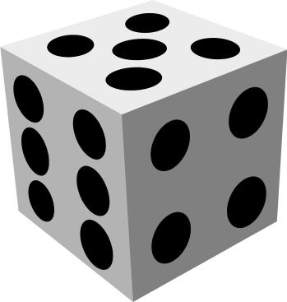
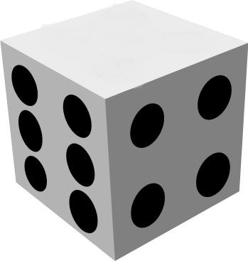


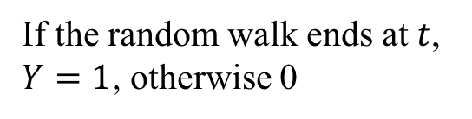
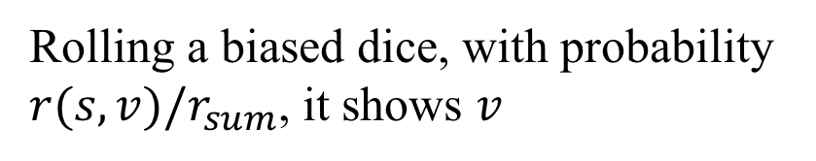


FORA Analysis (i)
$π\left(s,t\right)=\hat{π}\left(s,t\right)+\sum_{v∈V}{r\left(s,v\right)⋅π(v,t)}$
$r_{sum}=\sum_{v∈V}{r(s,v)}$
Define a random variable Y:
$$=X$$
Rolling a biased dice, with probability $r(s,v)/r_{sum}$, it shows $v$
v
$$v$$
If the random walk ends at $t$,
$Y=1$, otherwise 0
    $$E\left[Y\right]=X/r_{sum}$$
Notes:
We next show how we can derive approximate result with FORA. In the invariant. We regard this part as X, and define r_sum to be the sum of all residues. We then define a random variable Y as follows. We first roll a biased dice, such that with probability r(s,v)/r_sum it shows v, and if shows v, we start a random walk from v. If the random walk ends at node t, then Y=1. Otherwise Y=0. We can see that E[Y]=X/r_sum. With this equation, we can use Monte-Carlo approach to do the approximation.

Slide 25
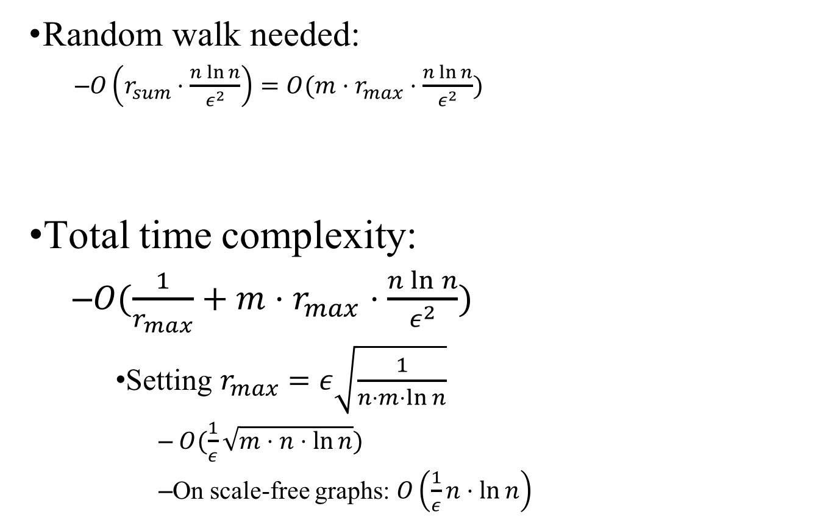

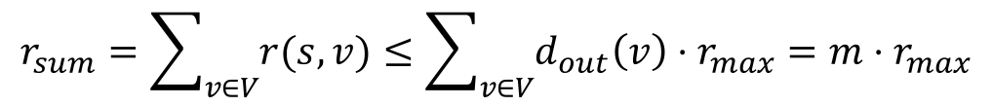
FORA analysis (ii)
    Random walk needed:
      $O\left(r_{sum}⋅\frac{n\ln{n}}{ε^{2}}\right)=O(m⋅r_{max}⋅\frac{n\ln{n}}{ε^{2}})$
Total time complexity:
  $O(\frac{1}{r_{max}}+m⋅r_{max}⋅\frac{n\ln{n}}{ε^{2}})$
    Setting $r_{max}=ε\sqrt{\frac{1}{n⋅m⋅\ln{n}}}$
      $O(\frac{1}{ε}\sqrt{m⋅n⋅\ln{n}})$
      On scale-free graphs: $O\left(\frac{1}{ε}n⋅\ln{n}\right)$
Monte-Carlo$:O\left(\frac{n\ln{n}}{ε^{2}}\right)$
$$r_{sum}=\sum_{v∈V}{r(s,v)}≤\sum_{v∈V}{d_{out}\left(v\right)⋅r_{max}=m⋅r_{max}}$$
Notes:
It can be proved that the random walk through this approach can be reduced by a r_sum fraction compared to the pure Monte-Carlo. Also it can be verified that r_sum can be bounded by m*r_max since (click). (Click). Recall that the forwrad push has a cost of 1/rmax. So in total, we have a cost of this one. (click) By setting rmax to this value, we derive the optimal time complexity, which is O(1/epsilon*sqrt(mnlnn). Also, we show that on scal-fre graphs, for instance social graphs, the complexity can be reduced to O(1/epsilonn n lnn).

Slide 26
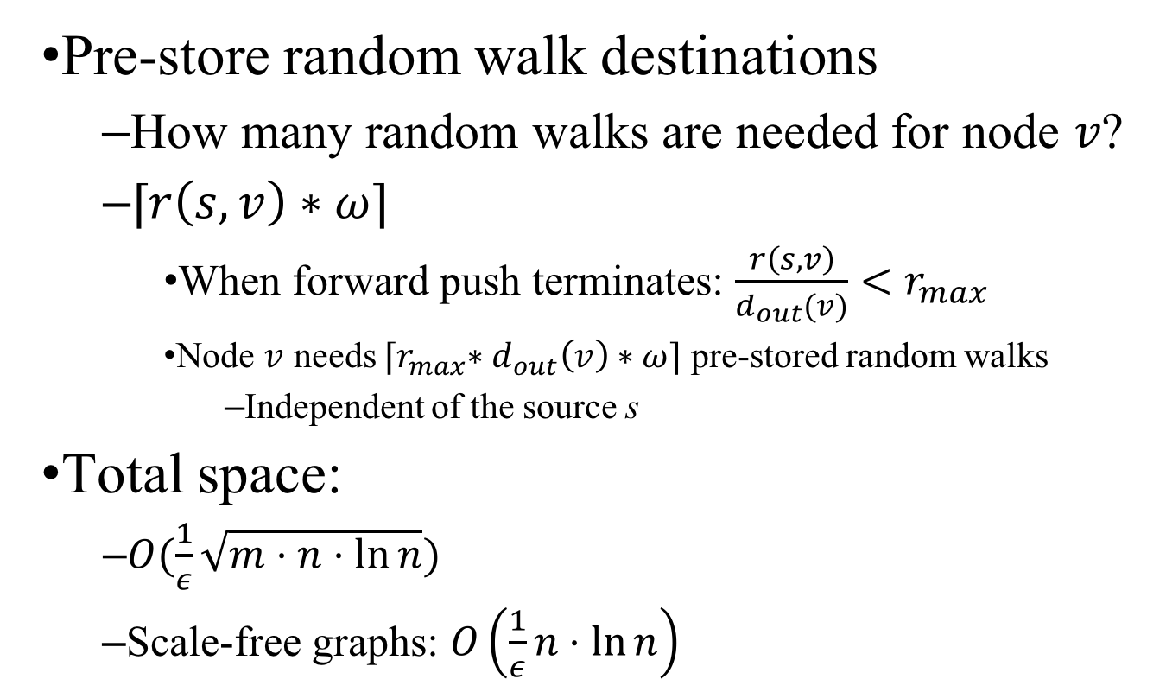
FORA+: Indexing the random walks
Pre-store random walk destinations
  How many random walks are needed for node $v$?
  $⌈r\left(s,v\right)∗ω⌉$
    When forward push terminates: $\frac{r\left(s,v\right)}{d_{out}(v)}<r_{max}$
    Node $v$ needs ${⌈r}_{max}∗d_{out}\left(v\right)∗ω⌉$ pre-stored random walks
      Independent of the source s
Total space:
  $O(\frac{1}{ε}\sqrt{m⋅n⋅\ln{n}})$
  Scale-free graphs: $O\left(\frac{1}{ε}n⋅\ln{n}\right)$
Notes:
The FORA algorithm provides a very good property that we only need to do a small portion of random walk from each node. So how many random walks are needed from each node v? In for a, we can bound it by ceil r(s,v)*\omega, where omega is the random walks required by Monte-carlo. (click) Also note that when forward push terminates , this inequation holds. So for node v, it needs rmax*dout(v)*omega pre-stored random walks. Here we can see that the number is indepenent of the choice of s. So it can be applied to arbitrary single-source query by prestoring this amount of random wallks for each node v.
In total the index structure only need O(1/epsilon\sqrt(m*n*logn) space, which is similar to the itme compleity. And On scaole free graphs, the index size is only O(1/epsilon nlo=nn)
So that’s all for the single source PPR query algorithm

Slide 27

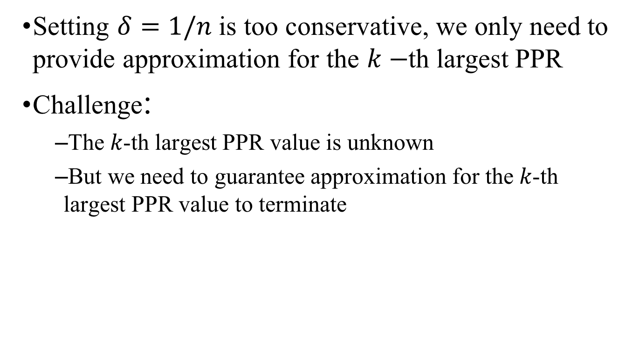
Top-$k$ single source PPR
Setting $δ=1/n$ is too conservative, we only need to provide approximation for the $k−$th largest PPR
Challenge:
  The 𝑘-th largest PPR value is unknown
  But we need to guarantee approximation for the 𝑘-th largest PPR value to terminate
Notes:
Net, we show how to hanle the top-k query with our FOR A framework. For the top-k queries, usually setting delat=1/n is too conserative. We actually only need approximation for k–th largest PPR.
Unfortunately, the k-th largest PPR value is unknow. But we need to gurante approximation for the kth largest PPR value to terminate. This is a chicken and egg problem and we provide a test-and-trial solution.

Slide 28

Top-$k$ single source PPR
Solution: test and trial
Stopping condition
  Deriving lower and upper bound for the estimated PPRs using concentration inequalities
Bound refinement
  Using the bound in last iteration to derive tighter bound
$$δ=1/k$$
𝛿=1/𝑘
Run FORA
Stopping condition test
Return the top-k answer
passed
Failed: $δ/=2$
Notes:
Initially we set delta=1/k and run the for a algorithm. We then use a stopping condition test to see if it the returned result satisfy the approximation guarantee. If it does then we immediately return the answer. Otherwise, we set delta to be half of its old value, and run FOR A again. We repeat this process until the approximation is guaranteed.
There are two tricky part in the topk algorithm. (click) One is how to set the stopping condition. We use the concentration inequalities to derive the lower and upper bounds of the estimated PPR values. We then make use of these bounds to check the approximation of the topk solutions. The stopping condition is rather complicated and we omit it here for the interest of time.
(click)
Another thing in our topk algorithm is that since we will run the FOR A multiple times, and each time we can derive some bound for the PPR values. We then can use the bounds in the last iteration to derive tighter bound in the current iteration. This can help the algorithm stop earlier and avoid unnecessary computations.
So that’s all for our topk algorithm.

Slide 29
Outline
Problem Definition
Existing work
Proposed solution
Experiments
Summary
Notes:
We next turn to the experimental evaluation part.

Slide 30
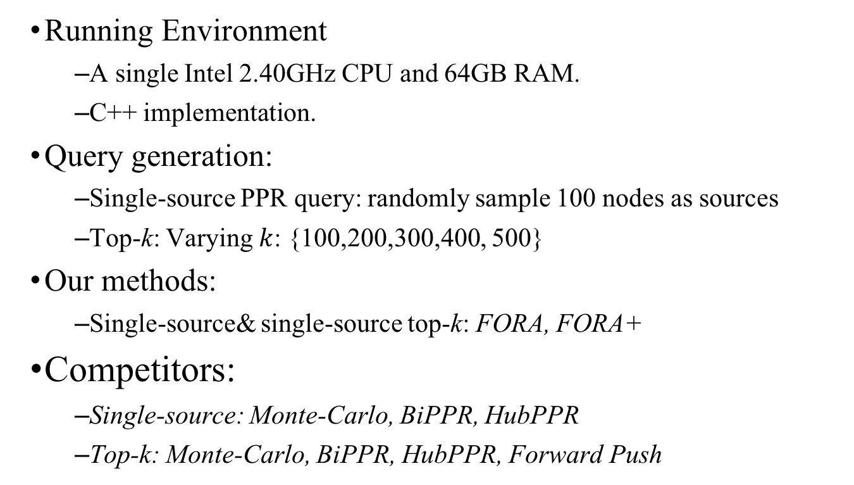
Experimental Setup
Running Environment
  A single Intel 2.40GHz CPU and 64GB RAM.
  C++ implementation.
Query generation:
  Single-source PPR query: randomly sample 100 nodes as sources
  Top-k: Varying $k$: {100,200,300,400, 500}
Our methods:
  Single-source& single-source top-k: FORA, FORA+
Competitors:
  Single-source: Monte-Carlo, BiPPR, HubPPR
  Top-k: Monte-Carlo, BiPPR, HubPPR, Forward Push
Notes:
We run our experiment on a single CPU with 64 GB memory and use C++ implementation.
For the single source query, we generate 100 source nodes randomly, and take the average. For top-k query, we vary k by 100 200 ..500 to see the impact of k.
Our methods are FOR A and FOR A+ for singlesource and tok queries. Our competitors include Monte-carlo BiPPR, and HubPPR for single source query. Note that BiPPR only works for pairwise PPR, and we have tuned the BiPPR so that it works best under the single source query.
HubPPR is an indexed version of the BiPPR algorithm. For the top-k query, we include Monte-carlo, bippr, hubppr and also the forwrad push algorithm. We tune the forwrad push so that it provides the same accuracy as our FOR A and FOR A+

Slide 31
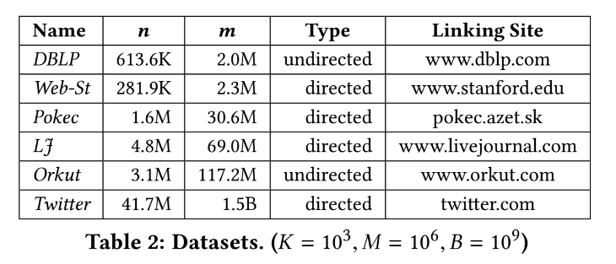
Datasets
Notes:
Here are the datasets we used. We use 6 datasets public avaiable from small graphs with 2million edges to large graphs with 1.5 billion edges.

Slide 32
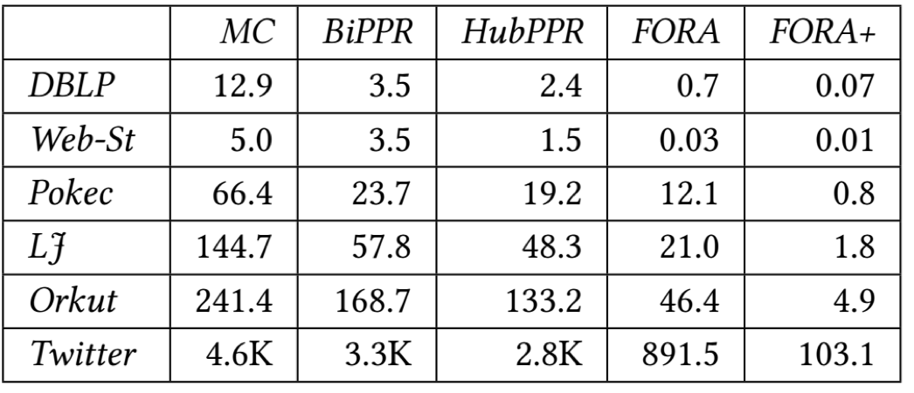
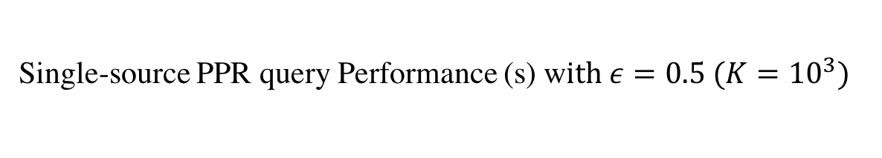
Single-source PPR query efficiency
Single-source PPR query Performance (s) w$ith ε=0.5 (K={10}^{3})$
Notes:
Here is the result for the single-source PPR query efficiency with epsilon set to 0.5. Here MC denotes Monte-carlo. The index size of HubPPR is set to be the same as FOR A+. We have several observations here. Firstly, FOR A is several times faster than BiPPR and Monte carlo on single source queries. For instance, On DBLP, it can be 5x faster than BiPPR, and 10x faster than Monte-carlo. The second observation is that our FOR A+ even though has a simple index, is very efficient. For instance on Twitter graph, FOR A needs 900 seconds, while our FOR A+ needs only around 100seconds, and is around 9x faster than FOR A, and can be 20x fasster than HubPPR, 30x faster than BiPPR, 40x faster than MC.

Slide 33
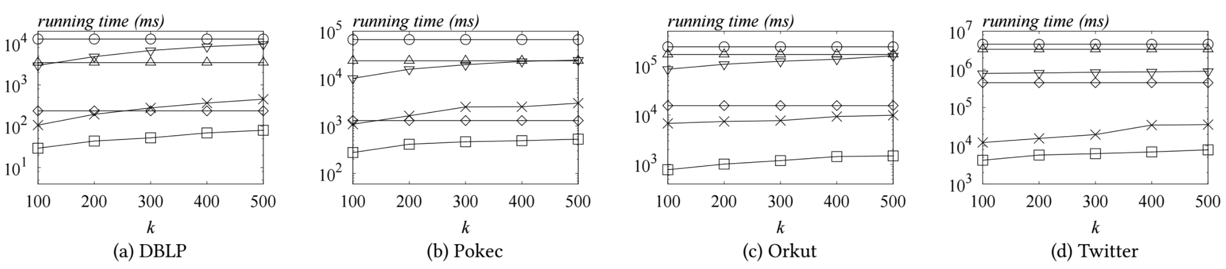
Single-source top-k PPR efficiency
Figure 1: single-source top-k PPR query efficiency
Notes:
Next, we turn to the singlesource top-k PPR query efficiency. The x-axis is k, and the y-axix is the running time in millenseconds. Note that the y-axis is log scale. We have the folowing obsevations.
Firslty, Our FOR A and FOR A+ are rather efficent in topk queries, and is t least two order magnitude faster than existing approximte solutions. In particular, on Twitter graph, our FOR A requires only tens of second, and FOR A+ requires only 5 second for the top-500 query. In contrast, HubPPR needs hundrens of seconds, and BiPPR MC needs hours.
Secondly, comparing with the heurstic forwrard push that provides same accuracy, our FOR A and FOR A+ proides comparable performance on small graphs, and improves over forward push significntly over large graphs like Twitter, where the improvement if more than an order of matnidue.

Slide 34
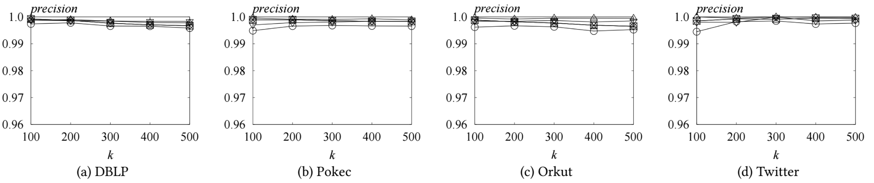
Single-source top-k PPR accuracy
Figure 2: single-source top-k PPR query accuracy
Notes:
Finally, we evaluate the accuracy of the topk PPR queryes. We use the power-iteration method with 500 iterations to derive the answers as ground-truth and compare the accuracy. S we can see, all methods actaully provide very high accuracy. Usually more than 99%. Under the similar accuracy, our FOR A and FOR A+ is orders of mmagnitude fster than existing methods, which indicates that our solutions are the preferred choice for the topk queries.

Slide 35
Conclusion
Efficient algorithm for single-source PPR queries
Efficient index structures
Efficient top-k PPR query algorithm
Notes:
To concluse, we have proposed efficient algorithm for single-source PPR quereis. We propose simple and efficient index structure to improve the query efficiency.
We further propose efficient topk ppr query algorithm.

Slide 36
Thanks
Q&A

Slide 37





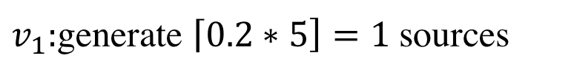
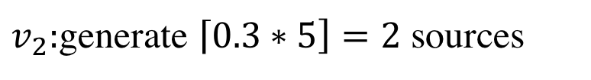
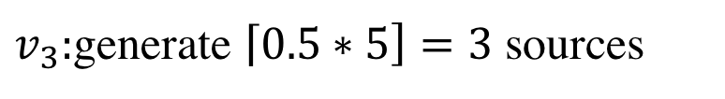
Optimizations (i): Efficient dice rolling
    $\left\{\left(v_{1},0.2\right),\left(v_{2},0.3\right), \left(v_{3},0.5\right)\right\},$ generate 5 source nodes
$$v_{3}$$
$v_{1}:$generate $\left\lceil 0.2∗5\right]=1$ sources
$v_{2}:$generate $\left\lceil 0.3∗5\right]=2$ sources
$$v_{2}$$
$v_{3}:$generate $\left\lceil 0.5∗5\right]=3$ sources
$$v_{3}$$
The deterministic dice rolling approach derives the same approximation guarantee as the left random one
$$…$$
Notes:
We have also several optimizations to improve the query efficiency. The first one is the efficient dice rolling. Imagine that we have the following probability distribution, and we need to generate 5 source nodes. Typicall, we will use the random generator to generate a node and repeat this process. For exampe, we first …
However, this process is still rather inefficient even thou we can have O(1) cost for each node generation. We propose to use the following determinstic solution. In particular, for v_1 we generate ceil(0.2*0.5) random walks, which is one. For v_2, we generate ceil(0.3*5)=2 random walks, and for v_3 wo do the same thing. We note that we will generate some more random walks, and intuitively if we do more sampling, we should be able to derive the same approximte results.
This inuitive idea turns out to actually hold

Slide 38


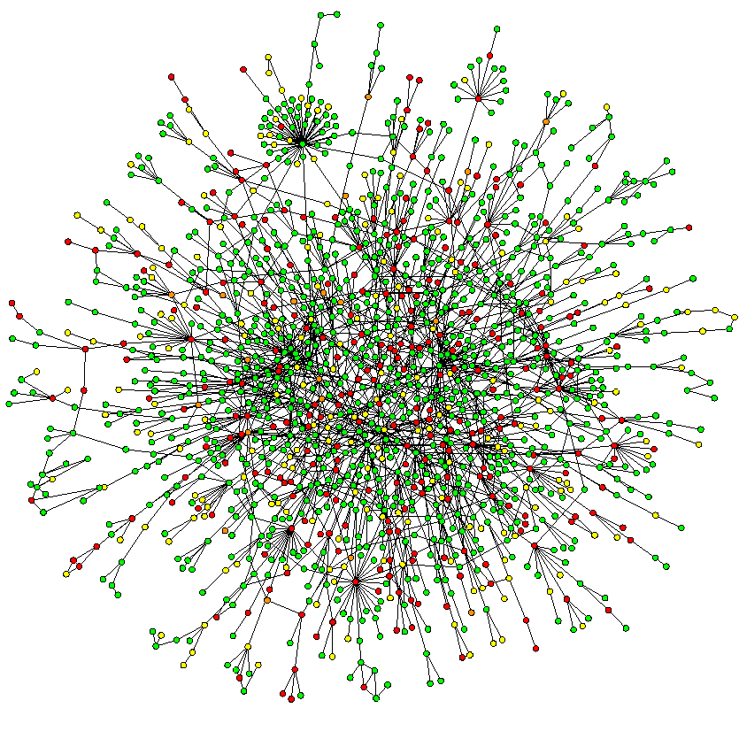
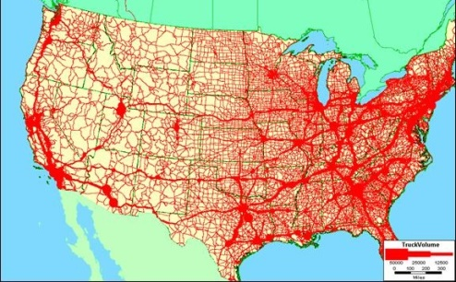
Graphs
Social networks
Web networks
Protein interaction networks
Road networks
Notes:
Graphs are a fundamental data structure to represent the objects and their relationships. For example, in social networks, each person can be represented as a node, and the friendship relationship can be represented as a edge, and we have a social graph. On a web network, each web page can be represented as a node, and the hyperlink from one page to another can be represented as an edge.
Similarly, we can build graphs for the protein interaction networks, and road network. On graphs, there are many important queries, and one of them is the personalized pagerank queries.

