Slide 1
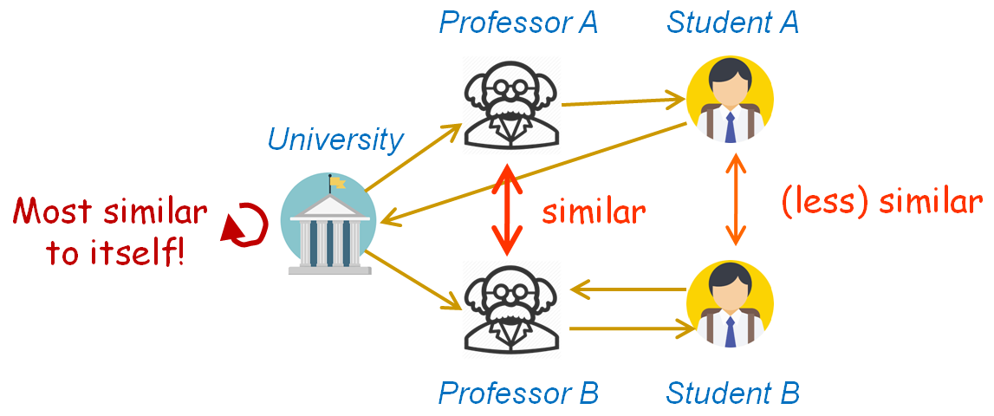
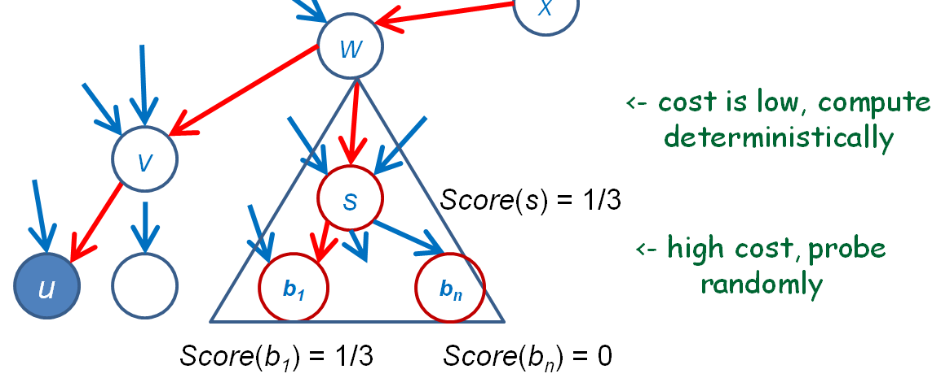
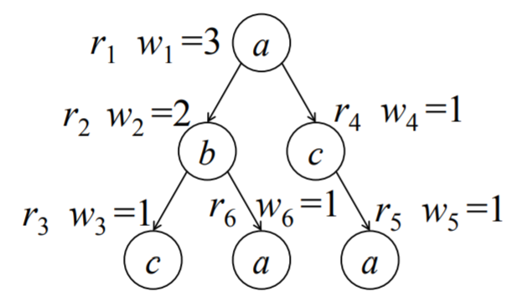
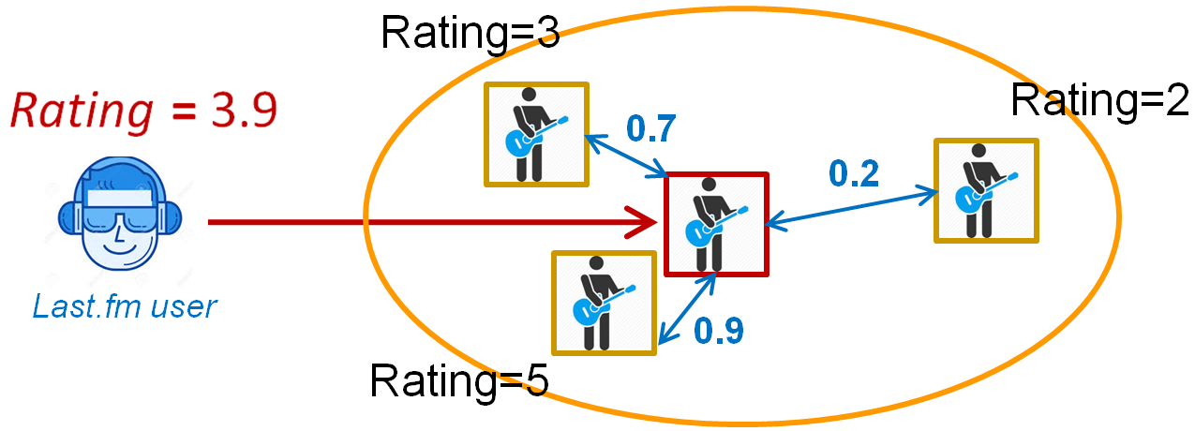
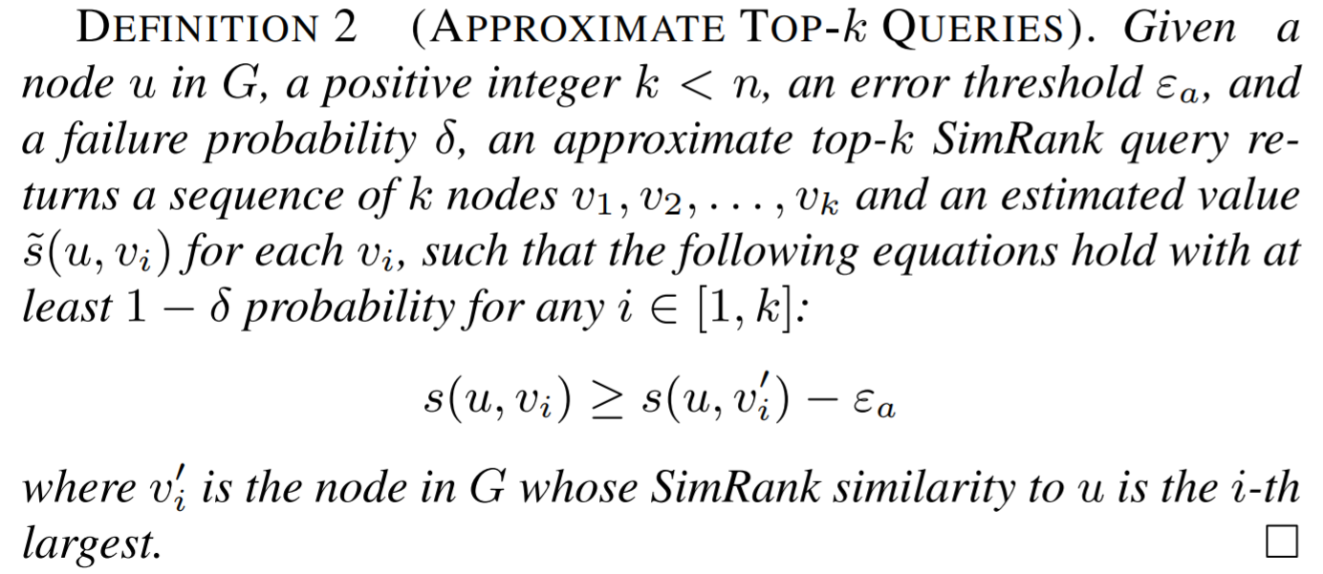
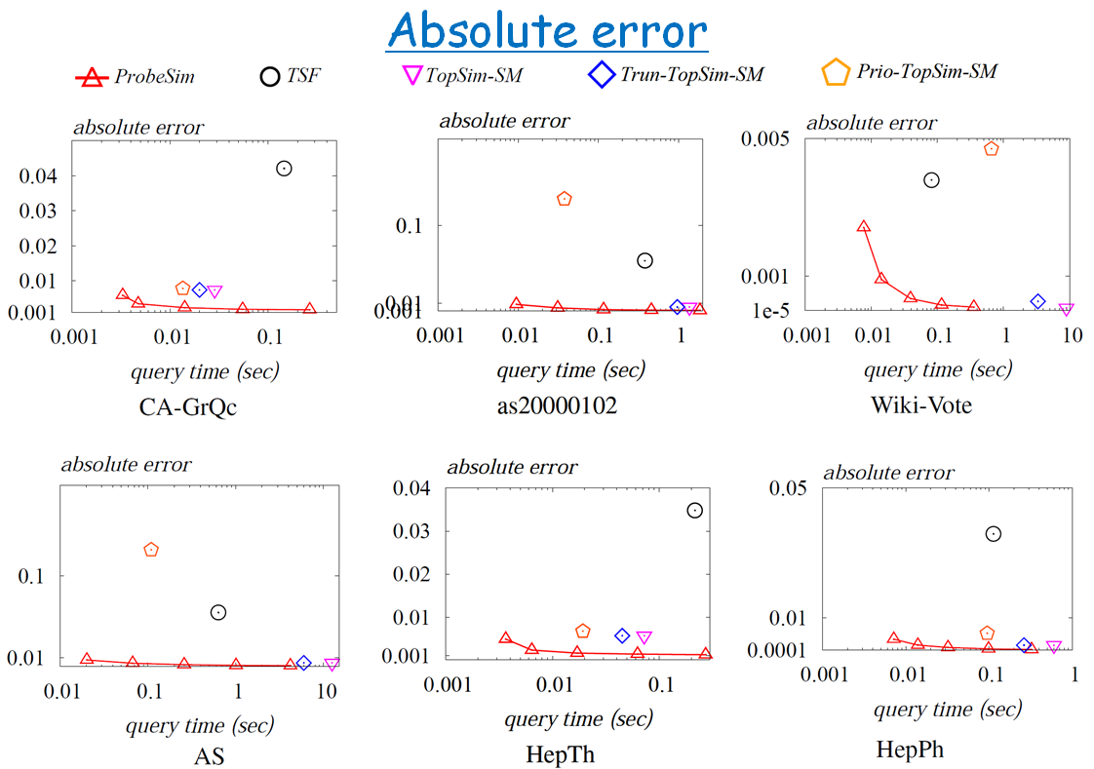
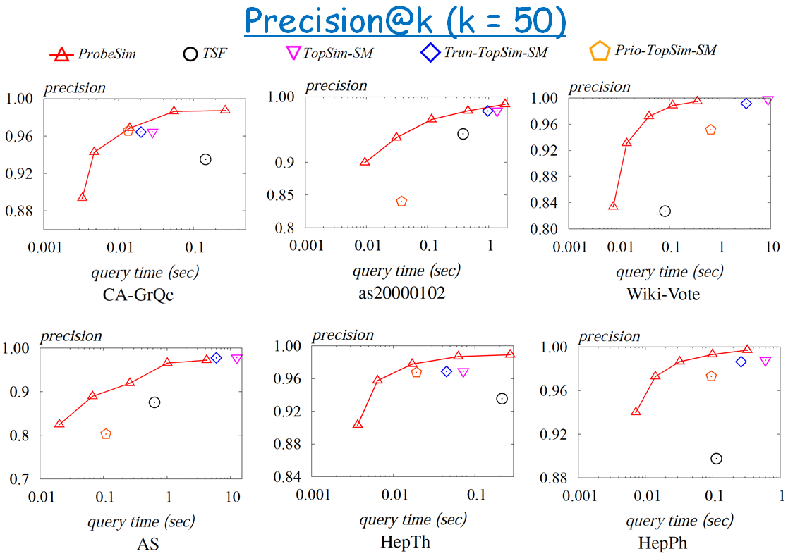
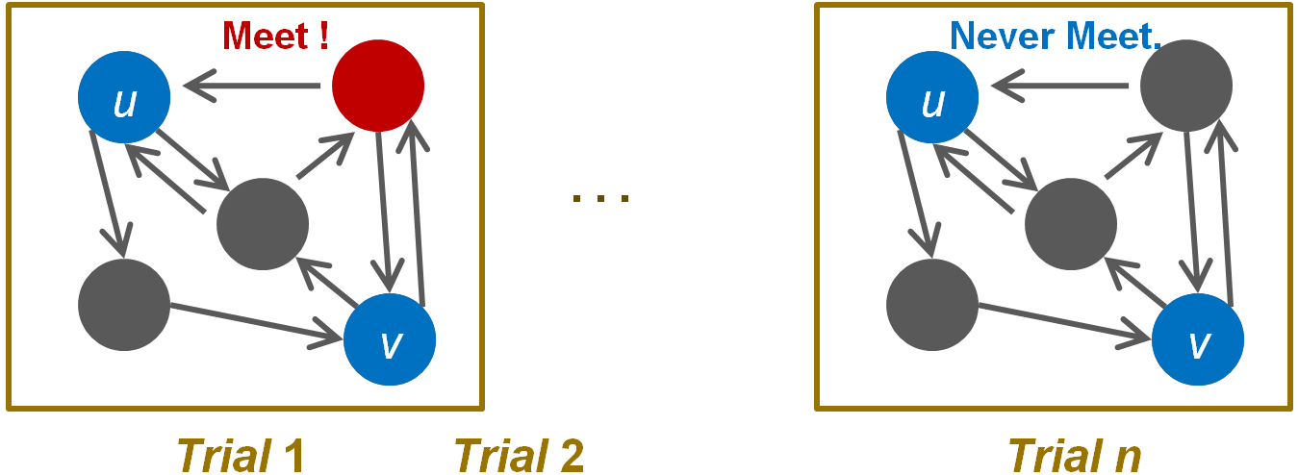
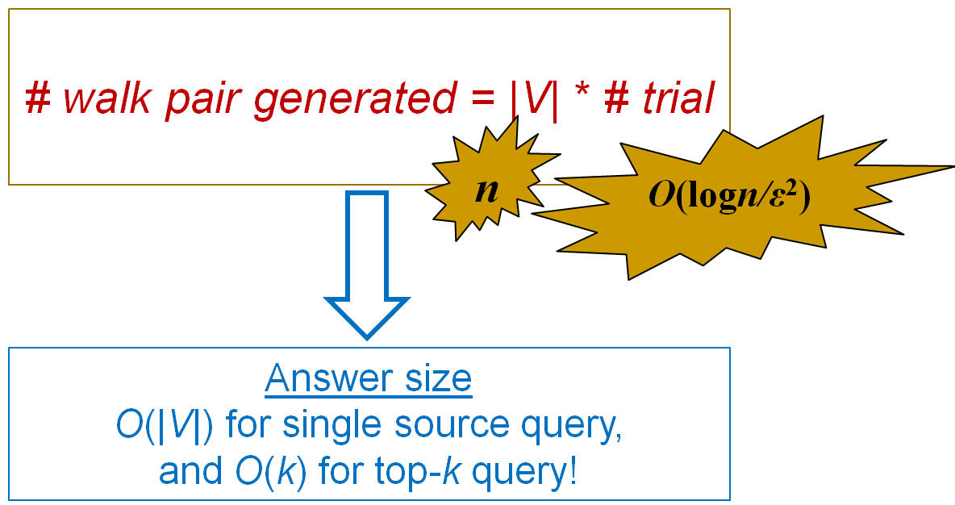
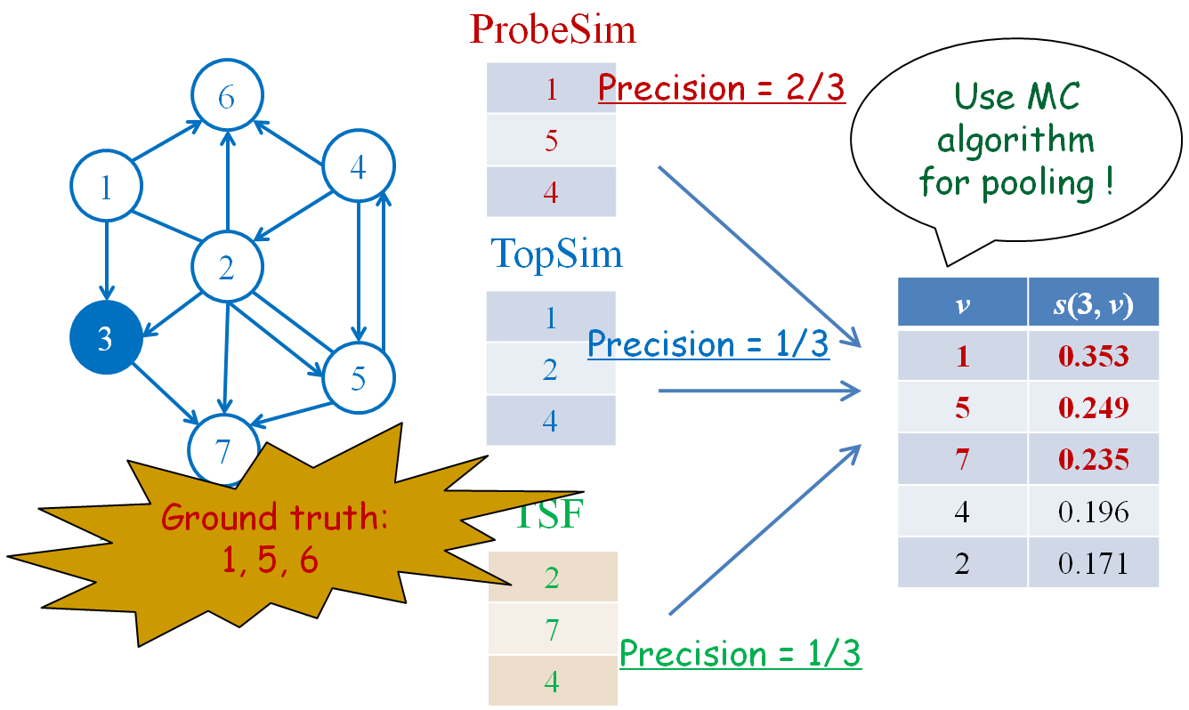
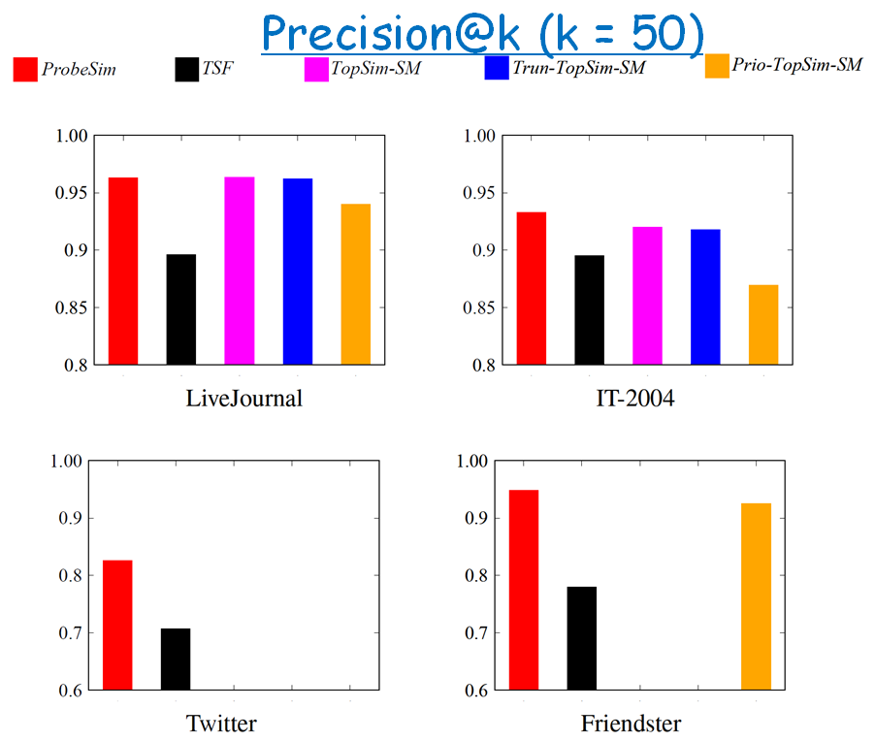
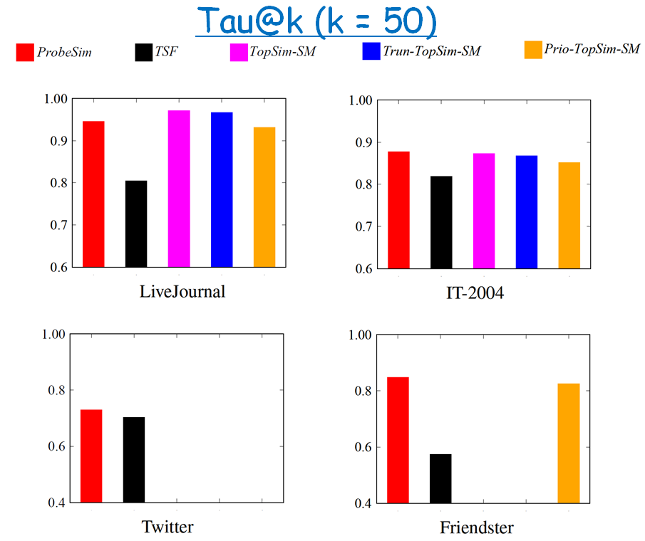
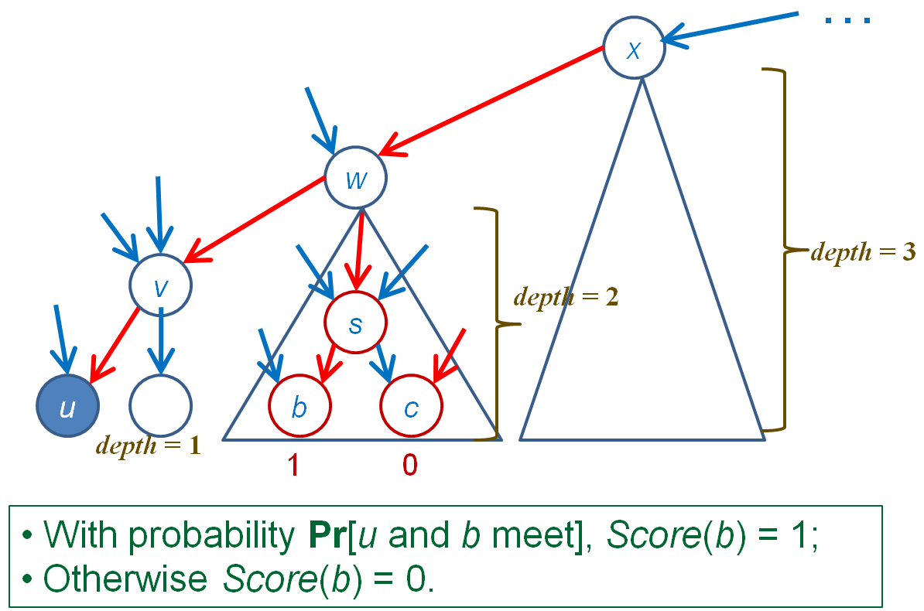
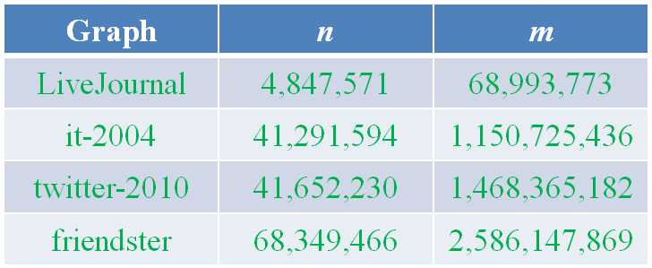
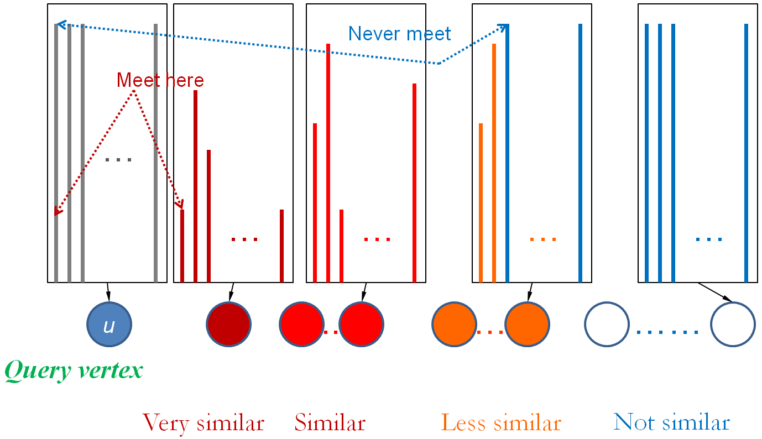
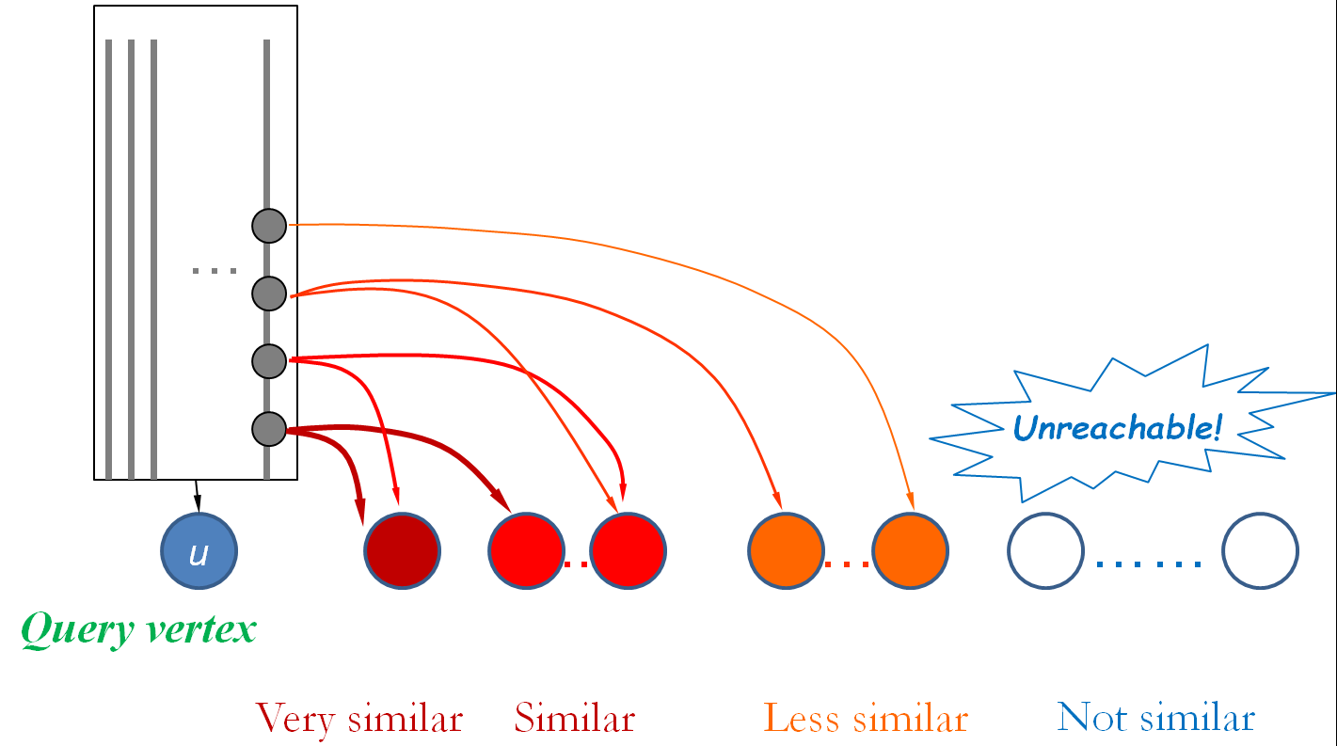
ProbeSim: Scalable Single-Source and Top-k
SimRank Computations on Dynamic Graphs
Yu Liu¹, Bolong Zheng², Xiaodong He¹, Zhewei Wei¹, Xiaokui Xiao³, Kai Zheng², Jiaheng Lu⁴
¹DEKE, MOE and School of Information, Renmin University of China. ²Department of Computer Science, University of Queensland. ³School of Computer Engineering, National University of Singapore.
⁴Department of Computer Science, University of Helsinki.
Motivation and Background
Optimizations
Definition of SimRank [Jeh & Widom, KDD02]
Probe deterministically
Batch up
Reverse reachability tree
Recursive equation
Random Surfer-Pairs Model
Theoretical Guarantee
Probably Approximately
Correct (PAC)
Applications
Experiments and Conclusion
Problem Statement
Top-k:
Small Datasets
Single source:
The Monte Carlo (MC) Algorithm [Fogaras & Racz]
Single pair:
Single source/Top-k:
Sampling-based algorithm
Pooling
Top-k:
State-of-the-arts
Query vertex: 3
Method | Time | Space | Drawbacks
TopSim [Lee et.al, ICDE12] | ~O(|D|^{2t}) | - | 1. Heuristics -> No accuracy guarantee; 2. Slow on large graphs.
TSF [Shao et.al, VLDB15] | O(R_{g}R_{q}t|V|) | O(R_{g}|V|) | 1. Assumption -> No accuracy guarantee; 2. Large sized index!
SLING [Tian & Xiao, SIGMOD16] | O(|V|/ε), O(|E|log₂1/ε) | O(|V|/ε) | 1. Large index and preprocessing time; 2. Do not support dynamic graph
k=3
The ProbeSim Algorithm
Large Datasets
Basic Idea
Forward random walk + Backward searching strategy
Intuition: ProbeSim vs. MC
Conclusion
First single source and top-k SimRank algorithm for dynamic graphs of
billion scale, and with theoretical accuracy guarantee
Outperforms existing methods in query efficiency, accuracy and
scalability
First evaluation on large graphs by pooling
MC
ProbeSim
Our code available at https://github.com/dokirabbithole/ProbeSim_vldb_pub

