Slide 1
Parameter-Efficient Mixture-of-Experts Architecture
for Pre-trained Language Models
$$†$$
Ze-Feng Gao *, Peiyu Liu *, Wayne Xin Zhao ,
Zhong-Yi Lu , Ji-Rong Wen
* equal contribution
corresponding author
$$†$$
Notes:
大家好，我是来自中国人民大学的博士后高泽峰，本次带来的分享是我们组在COLING 2022上的工作，叫《Parameter-Efficient Mixture-of-Experts Architecture for Pre-trained Language Models》，我的合作者是刘沛羽，赵鑫，luzhongyi和wenjirong。
我的主要研究方向是自然语言处理、预训练语言模型、模型压缩。
主要内容：今天的讨论中我会先为大家介绍一下混合专家模型的背景。将MoE应用到PLM中的主要挑战以及对应的解决方法。随后我会介绍我们组提出的基于张量分解方法的参数高效的混合专家模型架构。
本次分享的时间有限，因此公式推导以及具体细节不会太侧重，有兴趣的同学可以进一步关注我们的论文。

Slide 2
Outline
Introduction
Background
Motivation
Preliminary
Approach
Experiments
Conclusion
Notes:
这是本次分享的提纲，下面我首先介绍我们的工作的相关背景以及研究动机。

Slide 3
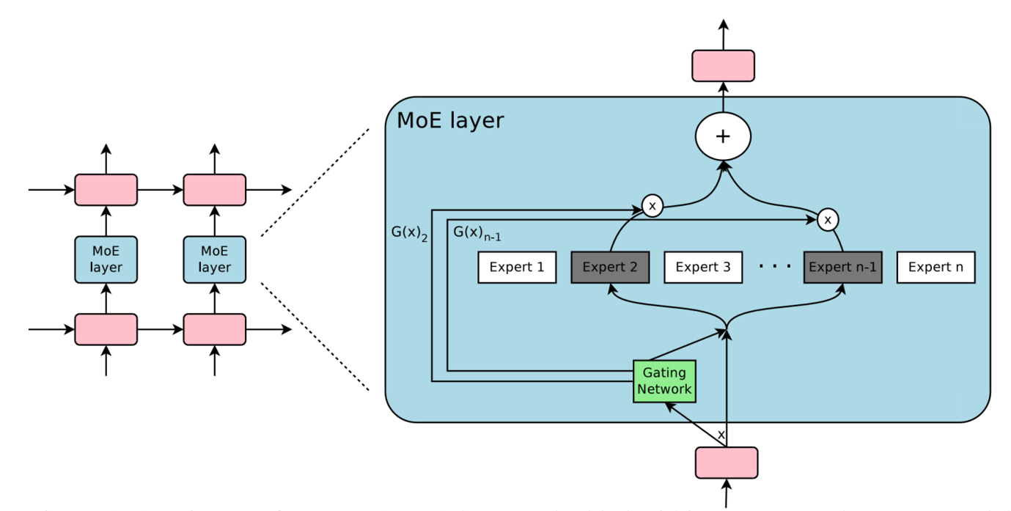
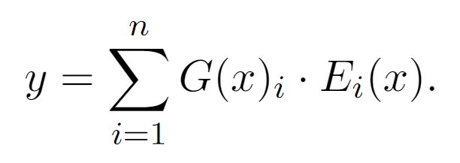
Introduction-Background
Mixture of Experts Architecture
(MoE for PLMs, Shazeer et al., 2017)
Shazeer N , Mirhoseini A , Maziarz K , et al. Outrageously Large Neural Networks: The Sparsely-Gated Mixture-of-Experts Layer[J]. 2017.
Notes:
Shazeer于2017年首次将MoE架构首次用于预训练语言模型。
具体来说，将Transformer结构中的全连接层FFN看做是一个“专家”，将这个专家扩展N次，就得到了N个专家结构。
输入的数据样本通过一个路由函数来分配到不同的专家中来处理，在图中绿色标注的就是路由函数G(X)，一般是用Softmax。
理想情况下，我们希望

Slide 4
Introduction-Background
Pre-trained Language Model with Mixture of Experts:
Shazzer et al. (2017) developing PLMs with MoE:
Drawback1: Unbalanced load between different experts
BASELayer (Lewis et al., 2021)
HashLayer (Roller et al., 2021)
GShard (Lepikhin et al., 2020)
Drawback2: High redundancy of parameters between different experts
Distillation Experts (Fedus et al., 2021)
Pruning the Experts (Kim et al., 2021)
Sub-network (Kudugunta et al., 2021, Zuo et al., 2021)
Sharing Parameters (MPOE)
Other application:
MoEfication (Zhang et al., 2021)
FastMoE (He et al., 2021)
Sparse expert model based on all-MLP (Yu et al., 2022)
Notes:
Recently, pre-trained language models have made significant progress in various natural language processing tasks. Actually, instead of training from scratch, pre-training and fine-tuning paradigm have become the standard of natural language processing. While, The large model size makes it impractical for resource-limited devices. For example, fine-tuning BERT_xlarge need to fine-tune one thousand two hundred and seventy million parameters.
However, we find only a small proportion of parameters will significantly change during fine-tuning although most PLM network need to fine-tune the whole network architecture.

Slide 5
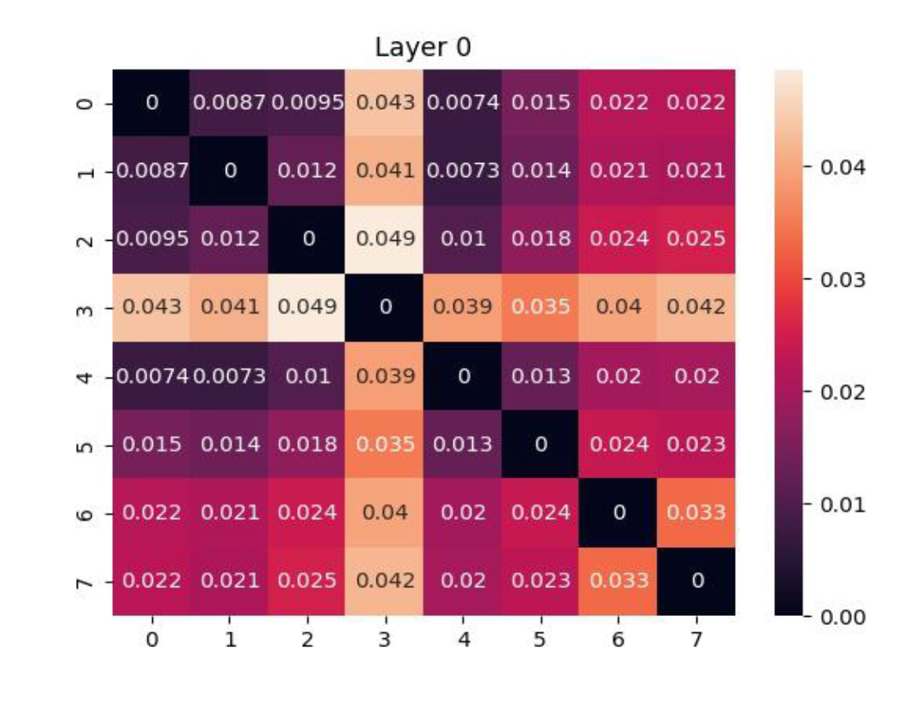
Our Observation:
High redundancy of parameters between different experts
After increasing model capacity with the MoE for the T5 model, the same inputs are used for 8 experts, and the Maximum Mean Discrepancy (MMD) of these expert output features are compared.
According to the MMD defination(Gretton et al., 2006) , it is obtained that different expert output features can be considered as the same distribution when the value of MMD is less than 0.178.
Notes:
Recently, pre-trained language models have made significant progress in various natural language processing tasks. Actually, instead of training from scratch, pre-training and fine-tuning paradigm have become the standard of natural language processing. While, The large model size makes it impractical for resource-limited devices. For example, fine-tuning BERT_xlarge need to fine-tune one thousand two hundred and seventy million parameters.
However, we find only a small proportion of parameters will significantly change during fine-tuning although most PLM network need to fine-tune the whole network architecture.

Slide 6
Introduction-Motivation
Matrix Product Operator (MPO)
MPO factorizes a matrix into a sequential product of local tensors.
Motivation:
Can we compress the central tensor for parameter reduction and update auxiliary tensors for lightweight fine-tuning?
The auxiliary tensors with only a small proportion of parameters play a role of complementing the central tensor
MPO
$${\{A}_{i}\}$$
$$M_{i×j}$$
$$A_{1}$$
$$A_{2}$$
$$C$$
$$A_{3}$$
$$A_{4}$$
The central tensor with most of parameters encode the core information of the original matrix
Figure 1: MPO decomposition for $M_{i×j}$.
$$C$$
Notes:
在解决这类问题过程中，我们发现，模型的有效压缩与轻量化微调涉及到对信息的有效提取与利用，模型的信息直接反映在模型的权重矩阵之中，那么如何有效抓住权重矩阵的重要特征就成为解决这类问题的重点方向。本文中，我们引入了这样一个方法MPO，在量子多体物理问题中，MPO分解是一种典型的可以将矩阵分解为一个张量序列的方法。具体为给定矩阵$M∈ℝ^{I×J}$，经过MPO分解后可以得到n个张量。我们看这里图示，A1到A4和C代表分解出来的张量。其中A包含了小部分的参数，我们在论文中称这种张量为辅助张量，而C我们称为中间张量，它包含了大部分参数，同时也包含了原始矩阵的大部分信息。最终辅助张量和中间张量的乘积就是原始矩阵。
那既然有这个参数分布的差异，我们的一个motivation就是，我们是否可以通过压缩中间张量C来实现模型的压缩，而微调A实现轻量化的微调。
In this paper, we introduce a novel matrix product operator, abbreviated as MPO, to compress pre-trained language model. This technique is an algorithm from quantum many body physics and it is used to factorizes a matrix into a sequential product of local tensors. From the picture, we can see, given a weight matrix M I j, we can get five tensors with MPO. A i and c denote auxiliary tensors and central tensor respectively.
An important merit of the MPO decomposition is that: the central tensor with most of the parameters encode the core information of the original matrix, while the auxiliary tensors with only a small proportion of parameters play the role of complementing the central tensor. Such a property motivates us to investigate a question: can we compress the central tensor for parameter reduction and update the auxiliary tensors for lightweight fine-tuning?
We will talk about our solution in detail for the next section.

Slide 7
Outline
Introduction
Preliminary
Approach
Experiments
Conclusion
Notes:
Then , we will talk deeply into technical part. First, let’s start with preliminary part.

Slide 8
Preliminary: Details of MPO decomposition
Auxilary Tensor
Central Tensor
Auxiliary Tensor
$$M_{I×J}$$
MPO
$$A_{4}$$
$$A_{1}$$
$$A_{2}$$
$$C$$
$$A_{3}$$
Any tensor change will affect the reconstruction matrix$M_{I×J}$
Contain most parameters and main information
MPO Feature
Each expert contains a different auxiliary tensor
Different experts share the center tensor
Tensor | $$A_{1}$$ | $$A_{2}$$ | $$C$$ | $$A_{4}$$ | $$A_{5}$$
Shape | $$1×3×4×12$$ | $$12×4×4×192$$ | $$192×4×8×384$$ | $$384×4×6×16$$ | $$16×4×4×1$$
Parameter Percentage | $$0.006\%$$ | $$1.45\%$$ | $$92.74\%$$ | $$5.80\%$$ | $$0.01\%$$
Enabling Lightweight Fine-tuning for Pre-trained Language Model Compression based on Matrix Product Operators. ACL 2021.
Notes:
这里我们用一个例子来解释MPO分解发生的事情，给定一个矩阵Mij，我们可以假设维度是768*3072大小，这里我们设定的参数I和J是[3,4,4,4,4]和[4,4,8,6,4]，那么我们分解后的情况如图所示，可以得到A1到A4其中d表示张量之间的链接建，下表中我们给出了张量的维度和参数量的统计信息，shape表示张量的形状，ratio表示张量参数量占总参数的比重，一个有意思的问题是，通过这个ratio我们看出来，中间张量几乎占据了大部分的参数。

Slide 9
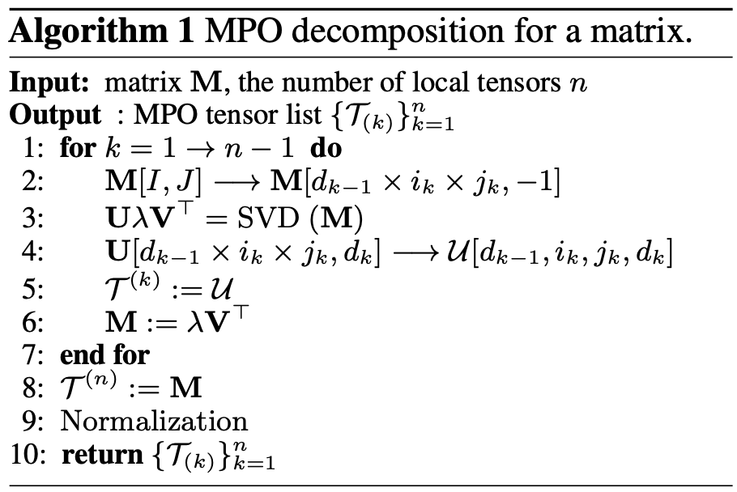
Preliminary: Details of MPO decomposition
MPO: matrix product operator technique from quantum many-body physics for compressing PLMs.
Matrix decomposition with MPO:
The bond dimension $d_{k}$ is defined by:
$$MPO\left(M\right)=\prod_{k=1}^{n}{𝒯_{(k)}\left[d_{k−1},i_{k},j_{k},d_{k}\right]}, (1)$$
$$d_{k}=\text{min}\text{(}\prod_{m=1}^{k}{i_{m}×j_{m}},\prod_{m=k+1}^{n}{i_{m}×j_{m}}\text{). (}\text{2}\text{)}$$
Notes:
公式：在前面一个直观的介绍，我们这里深入一下MPO的执行细节和一些误差的计算。公式1，其中$𝒯_{\left(k\right)}\left[d_{k−1},i_{k},j_{k},d_{k}\right]$是第$k$个4阶张量，$i_{k}$和$j_{k}$是提前设定好的超参数，$d_{k}$称为不同张量之间的连接键，其计算方式为如公式2。
算法流程图：输入矩阵M和需要分解的张量数量n，我们需要进行一个n次的循环，其中每一次循环中都需要包含一个SVD分解的过程，最终再对得到的张量进行正则化。

Slide 10
Outline
Introduction
Preliminary
Approach
Experiments
Conclusion
Notes:
前面介绍了MPO方法之后，我们后面介绍如何用这种特性来实现我们提到的模型压缩和轻量化微调。

Slide 11
Approach
Motivation
We can achieve a more parameter-efficient MoE architecture for pre-trained language models by sharing the central tensor among different experts.
Solution
MPO-based Mixture of Experts
Alleviate unbalanced optimization issue with Gradient Mask
Notes:
we propose an MPO-based compression approach for PLMs, called MPOP
And we give the overview of our final solution that, we propose a lightweight fine-tuning strategy with auxiliary tensors and an optimizing algorithm named as dimension squeezing for stacked architecture optimization. Next, I will introduce the solutions in two parts.

Slide 12
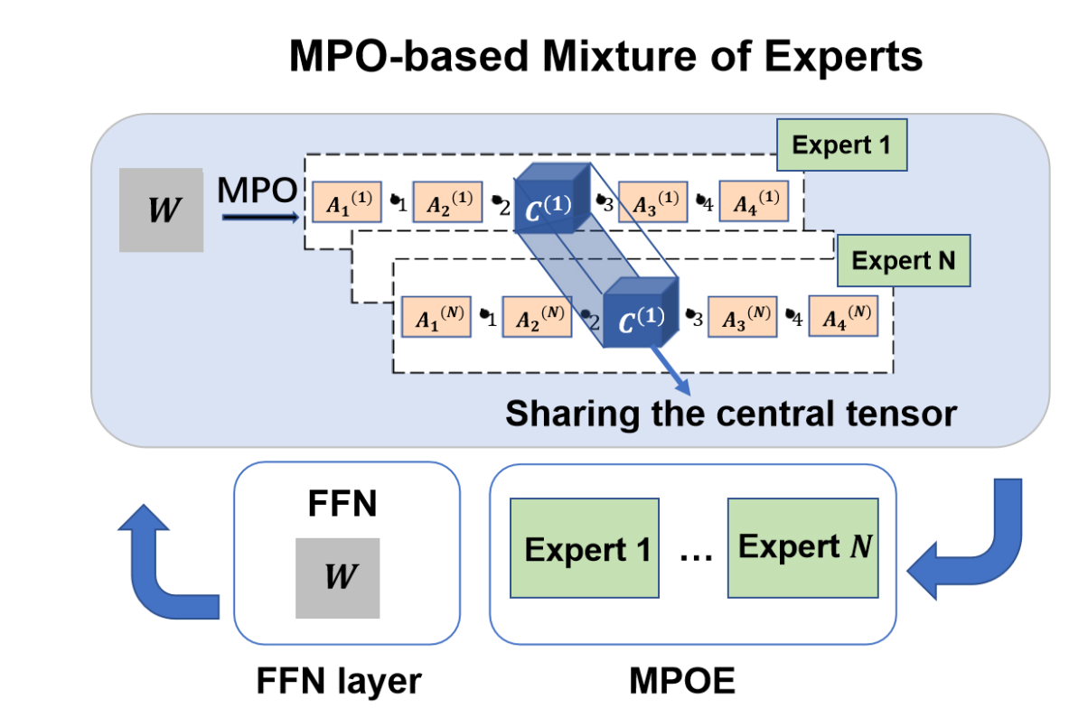
Part1: Sharing Central tensor across experts
Sharing parameters of the central tensor $C$
$$C$$
Parameter-Efficient Mixture-of-Experts Architecture for Pre-trained Language Models. arXiv:2203.01104.
Notes:
在MPOE方法中，我们通过将专家中的参数矩阵进行MPO分解，得到中心张量C与辅助张量A。
在不同的专家中共享中心张量C的参数可以实现MPOE策略。

Slide 13
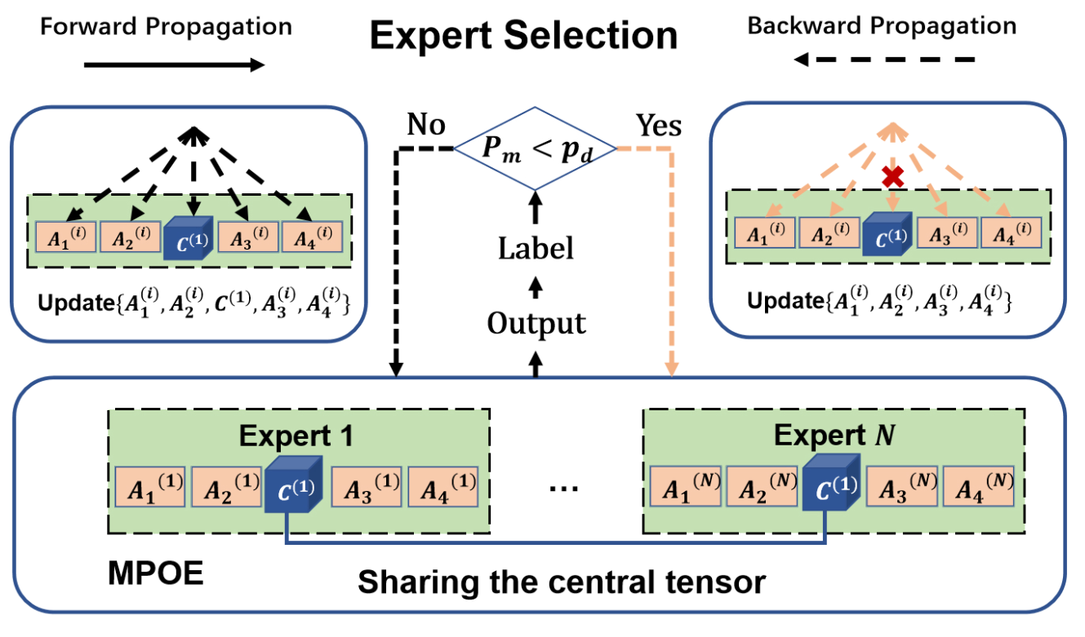
Part2: Alleviate unbalanced optimization issue
$$C$$
Gradient masking strategy
Parameter-Efficient Mixture-of-Experts Architecture for Pre-trained Language Models. arXiv:2203.01104.
Notes:
因为在不同的专家中共享了中心张量C的参数，这会导致每个输入样本都会使得中心张量的参数更新。
这会导致中心张量与辅助张量的更新频次差异巨大而产生过拟合，我们设计了中心张量的梯度掩蔽策略来避免这种过拟合问题。
右边的公式b代表的是伯努利分布，我们以p_d的概率对中心张量的梯度做了掩蔽操作。使得中心张量不更新。

Slide 14
Outline
Introduction
Preliminary
Approach
Experiments
Experimental Results
Detailed Analysis
Conclusion

Slide 15
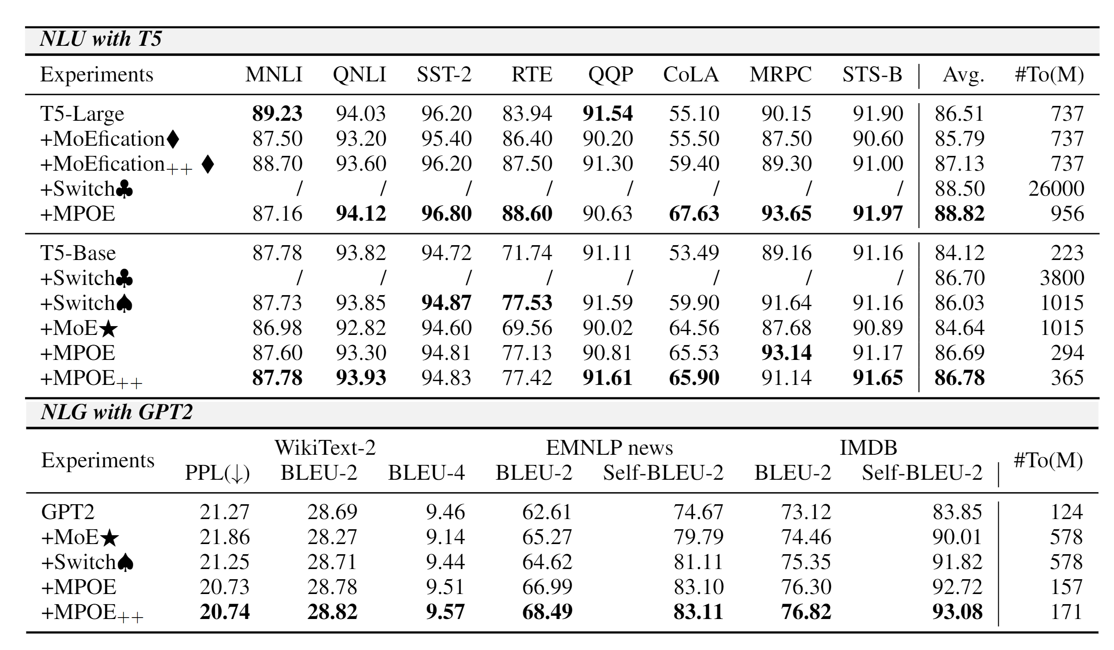
Experimental Results
♠: Our re-implementation of (Fedus et al., 2021).
⋆:Apply method of (Shazeer et al.,2017) on T5.
♦: Experimental results of (Zhang et al., 2021)
♣: Experimental results of (Fedus et al., 2021)
Notes:
As shown in Table 3, our approach MPOP is very competitive in the GLUE benchmark, and it outperforms ALBERT in all tasks (except MNLI) with a higher overall score of 79.7. Looking at the last column, compared with ALBERT, MPOP reduces total parameters by 22% .In particular, it results in a significant reduction of pretrained parameters by 91%.

Slide 16
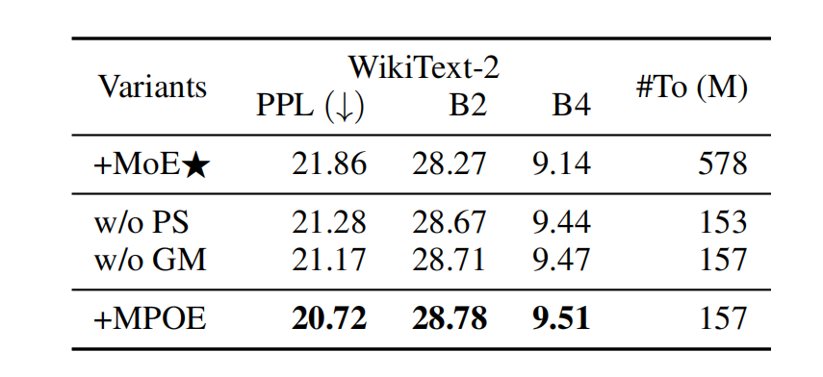
Experimental Results
Ablation results
Ablation study on the WikiText-2 dataset aboutthe NLG tasks (in percent).
“w/o PS” denotes without Parameter Shareing strategy.
“w/o GM”denotes without Gradient Masking strategy.
B2 and B4 are short for BLEU-2 and BLEU-4, respectively.
Notes:
Comparing MPOP full and MPOP full plus LFA, we note that fine-tuning all the parameters seems to have a negative effect on performance. For example , RTE and MRPC
Comparing MPOP and MPOP dir, we find dimension squeezing algorithm plays a key role in improving our approach, since it is tailored to stacked architecture.

Slide 17
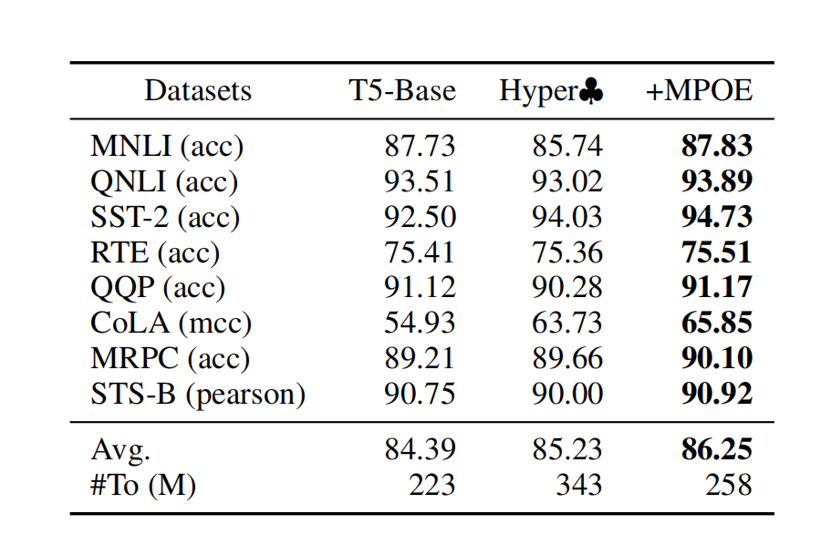
Experimental Results
Ablation results
The MPOE method can obtain promising results in multi-task learning, where the shared central tensor can effectively obtain relevant information between different tasks.
♣: Experimental results from Hyperformer (Mahabadi et al., 2021).
Performance of multi-task learning on GLUE benchmark obtained by fine-tuning T5-Base (in percent).
Notes:
from table 4, our approach provides a more principled way for lightweight fine-tuning than fine-tuning the last 1-3 layers of BERT.
from table 5, Our method can be applied to either uncompressed or compressed PLMs.
and Our approach can substantially reduce the network parameters, especially ones to be fine-tuned.

Slide 18
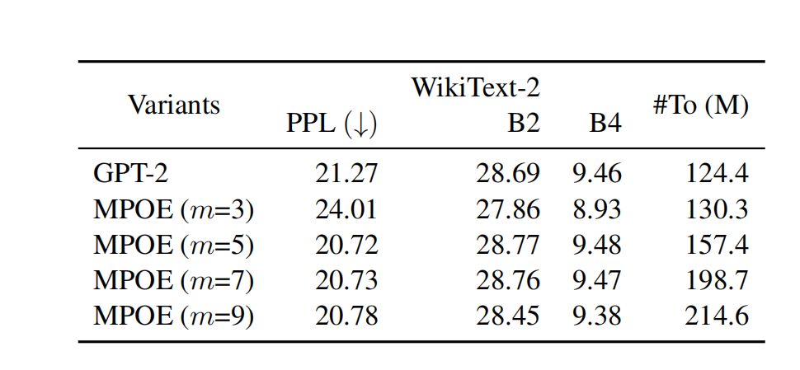
Experimental Results
experimental analysis
Different MPO decomposition lengths have little effect on the results
Considering the trade-off between cost and quality, the experiment chose $m = 5$.
Evaluation with different factorization manner on the WikiText-2 dataset about the NLG tasks (in percent).
Notes:
上面的图(a)中对比了CPD和MPO方法的压缩效果，发现在同样的压缩率条件下，MPO有着更低的重构误差，在图(b)中，我们测试了MPO展开成的张量的数目对重构误差的影响，结果发现，采用2,3,5,7不同的张量数目，并不会对重构误差有明显的影响

Slide 19
Outline
Introduction
Preliminary
Approach
Experiments
Conclusion

Slide 20
Conclusion
We proposed an MPO-based MoE architecture for PLM. With MPO decomposition, we were able to reorganize and aggregate information in central tensors effectively. Inspired by this, we make following contributions:
Sharing central tensor: we could explore a parameter-efficient MoE architecture based on MPO decomposition.
Alleviate Overfitting with Gradient Mask: we could optimize MPO-based MoE more stablely.
Notes:
To our knowledge, it is the first time that MPO decomposition had been applied to compress PLMs.

Slide 21
Q&A
Source code
https://github.com/RUCAIBox/MPO/MPOE
Thank you

